Slide 1

BODAH Project
Flow Management Model
Miguel PAZOS OTÓN

Slide 2
SUMMARY
Introduction
Case studies
Data analysis and quantitative model
Qualitative model
Conclusions

Slide 3
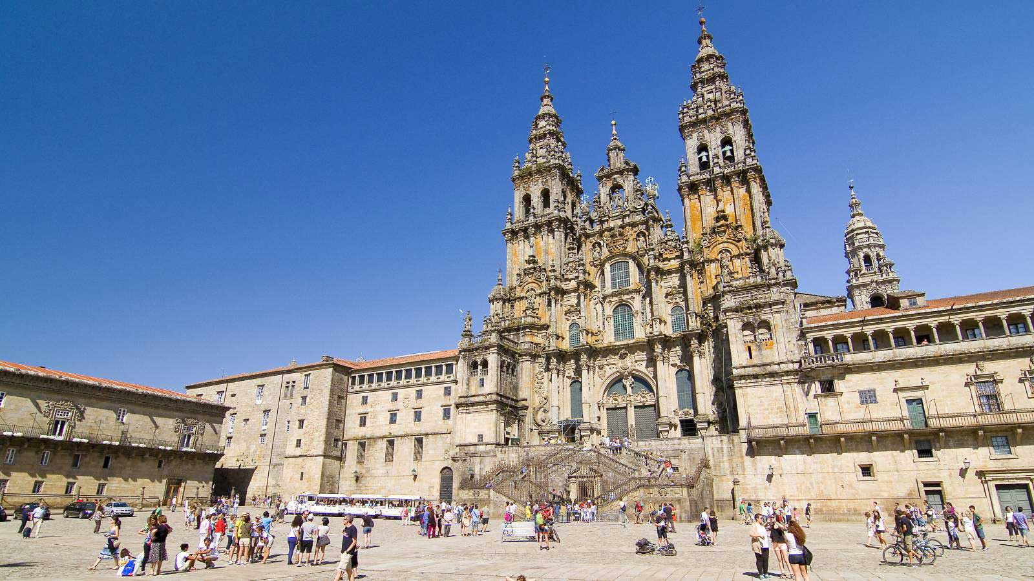
SANTIAGO DE COMPOSTELA

Slide 4
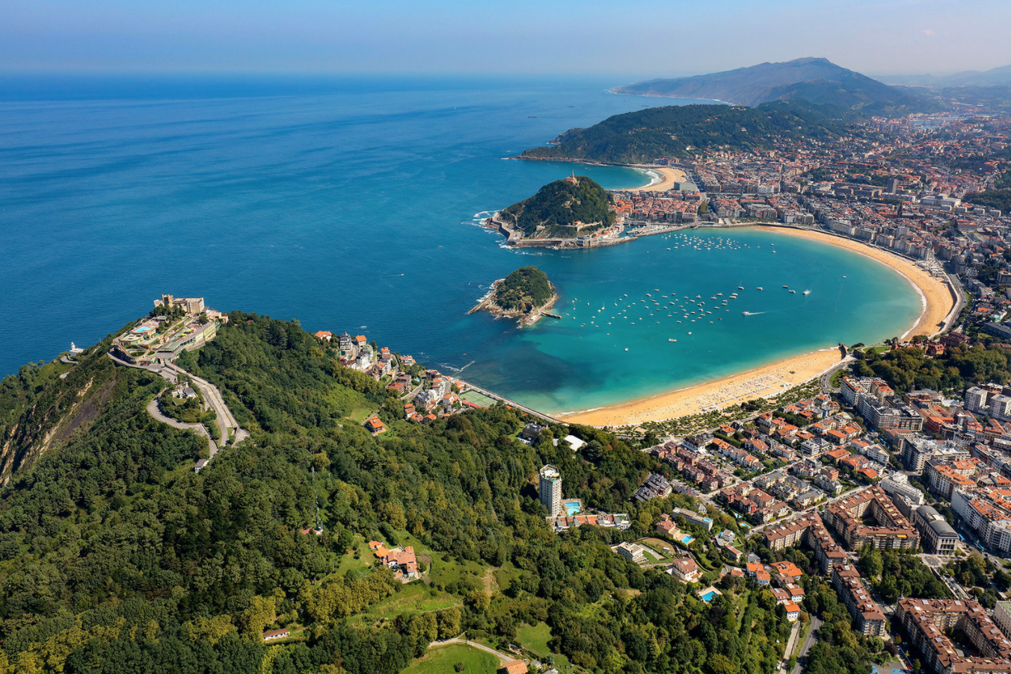
DONOSTIA-SAN SEBASTIÁN

Slide 5
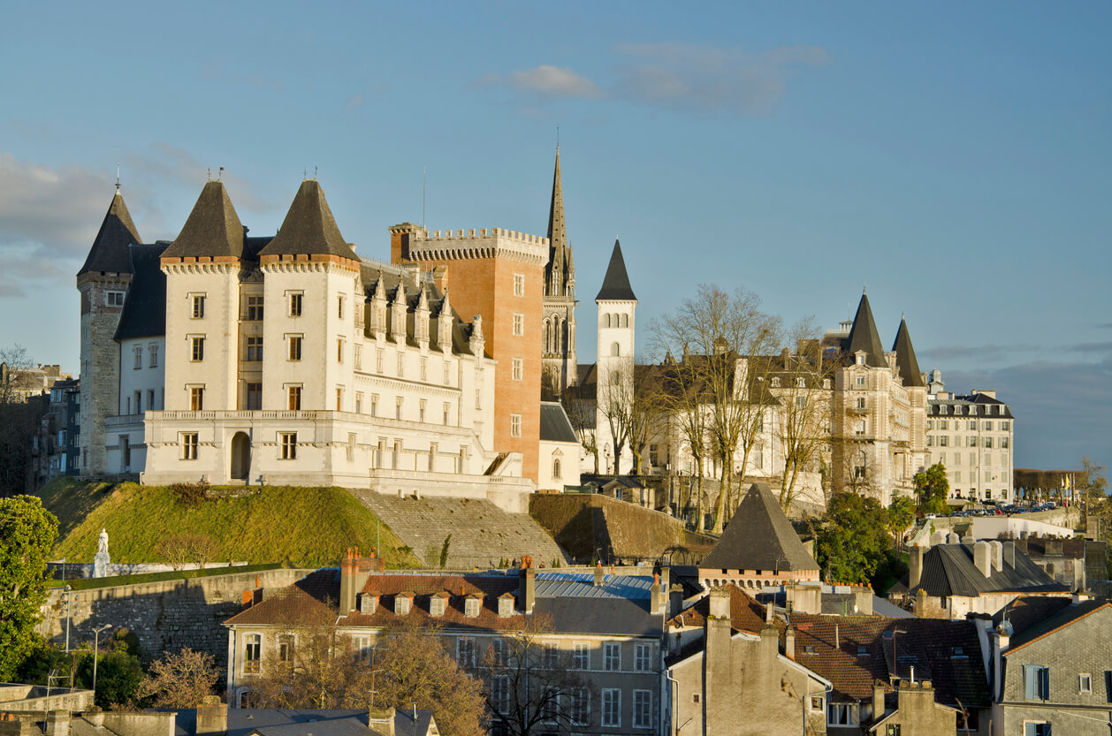
PAU

Slide 6
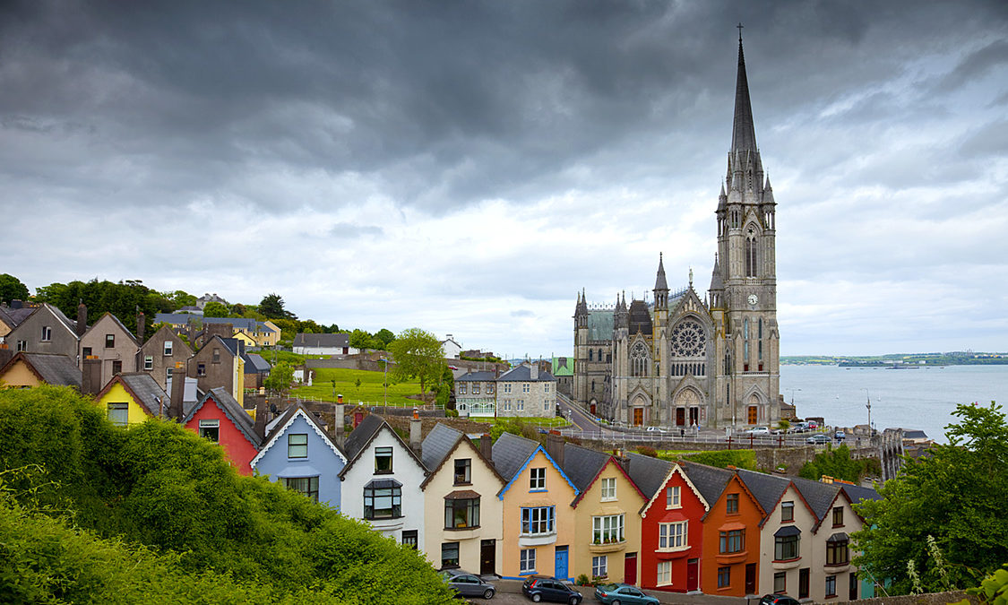
CORK

Slide 7
TOURIST CARRYING CAPACITY IN THE CITY OF SANTIAGO DE COMPOSTELA. ANALYSIS OF PERCEPTIONS FROM SURVEYS
Analysis of the tourist saturation in the Historic Center of Santiago de Compostela based on the perceptions of visitors and residents.
Surveys were carried out on both groups in the months of August and October 2021.
The methodology used consisted of the development of a descriptive statistical analysis, inferential statistical analysis, factorial analysis and multivariate cluster analysis to classify both visitors and residents according to the perceptions related to the sensation of saturation, security, cleanliness and hygiene, perception of the state of conservation of heritage and perceptions related to trade and hospitality
The data obtained were processed with the SPSS program (vers. 25.0).

Slide 8
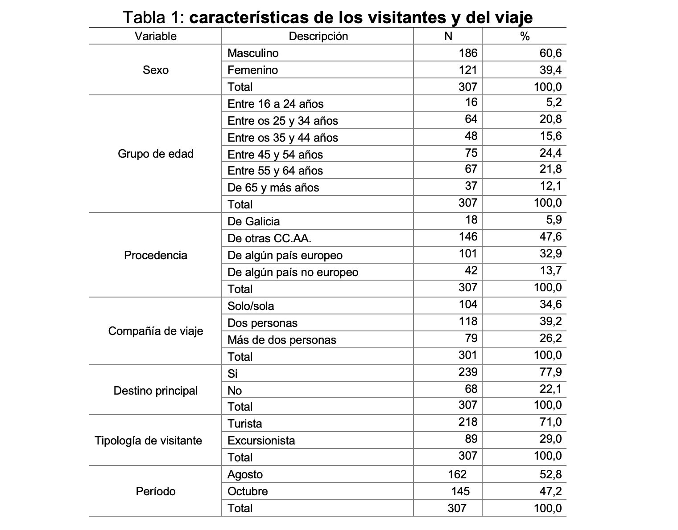

Slide 9
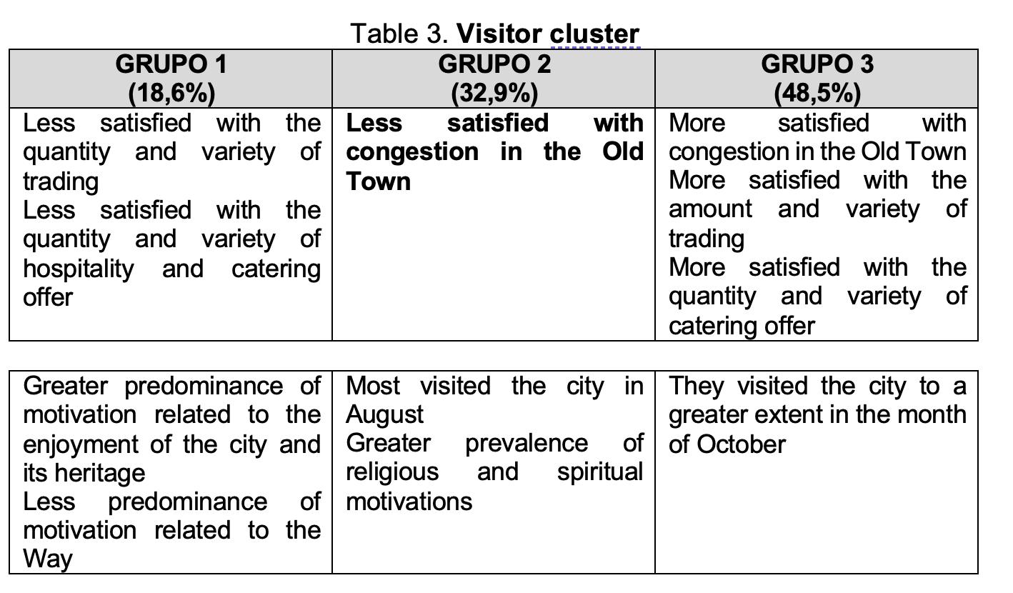

Slide 10
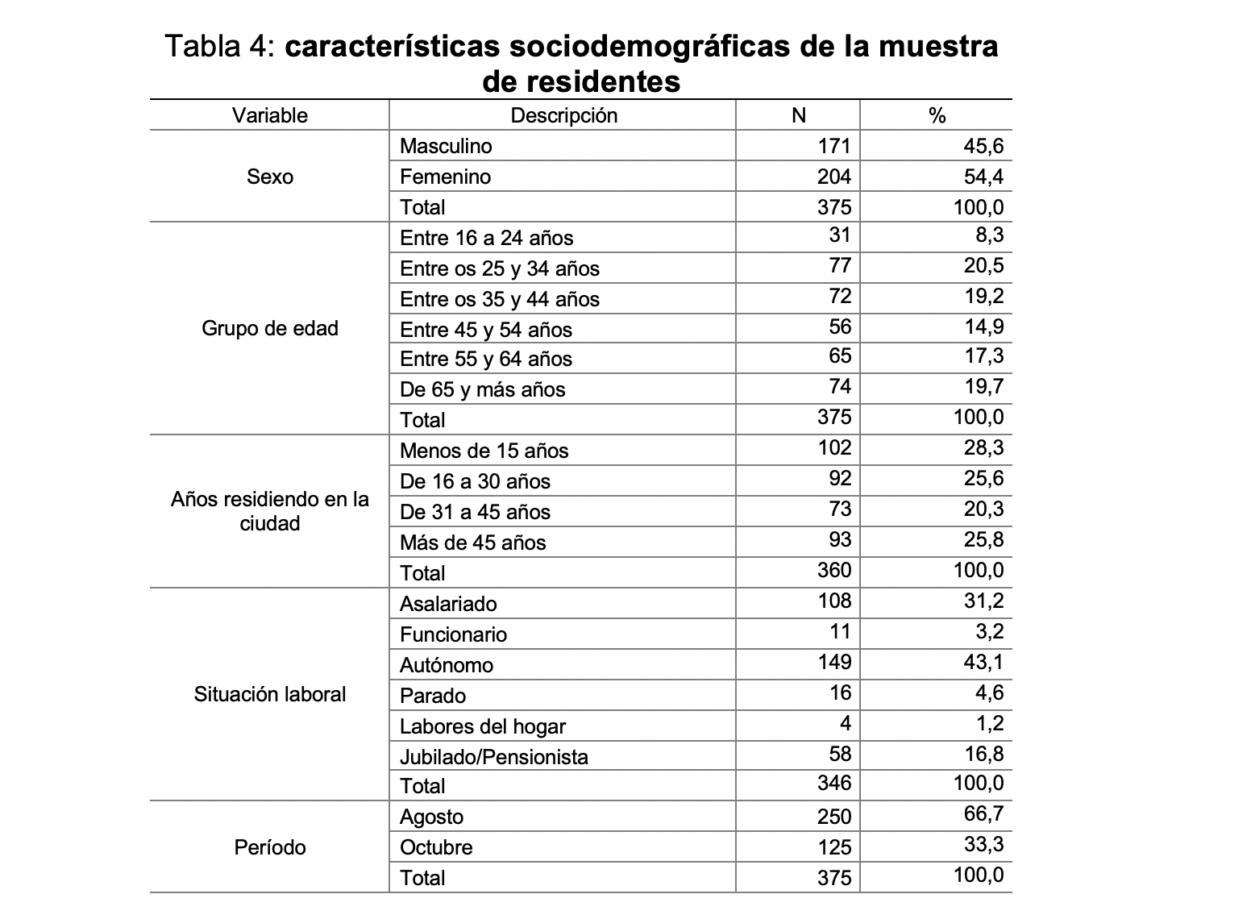

Slide 11
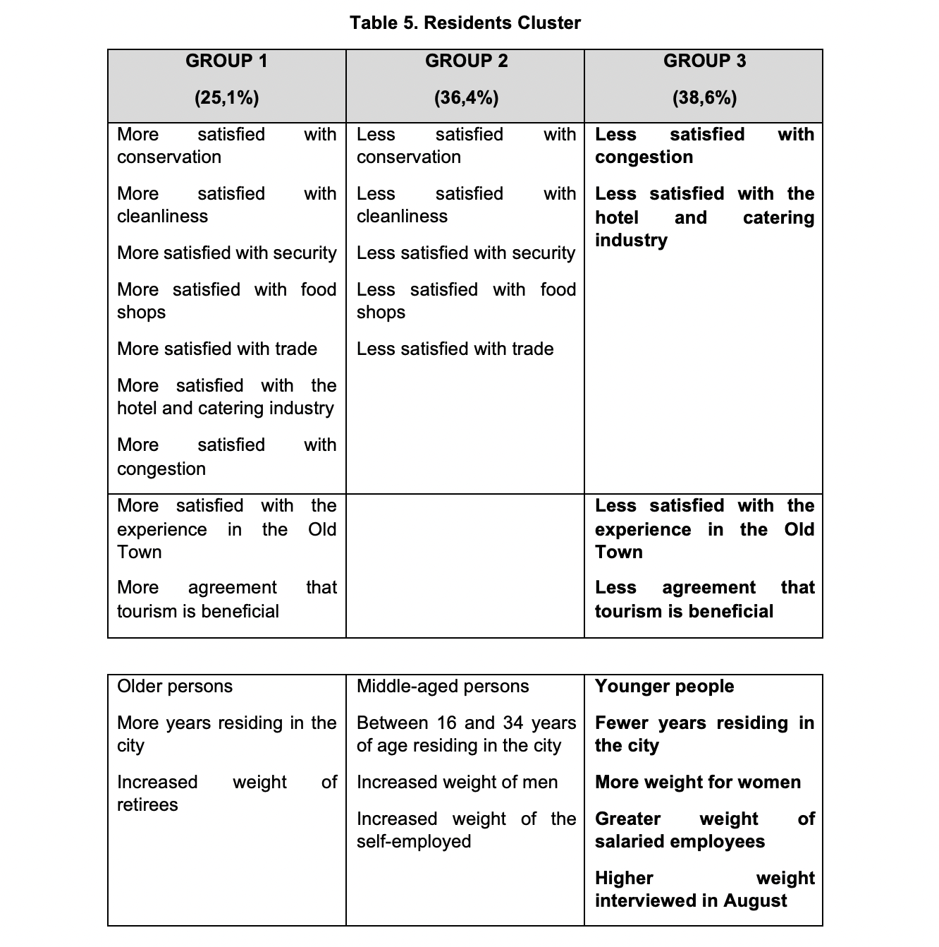

Slide 12
From the work carried out, a series of conclusions can be drawn that will help in making decisions related to the management of tourist flows in the city
In the first place, and as seems evident, there are significant differences between visitors and residents in various aspects related to tourist saturation or congestion
Generally, reviews are more positive for visitors than for residents
Residents are aware of the importance of tourism for the city, but this does not prevent the development of tourist activity from generating a series of negative impacts on the development of daily life.

Slide 13
Within the aspects included to evaluate the perception of saturation, the best valued by visitors have been the "quantity and variety of the hotel and restaurant offer", the "general state of cleanliness" and the "state of conservation of monuments and tourist assets” of the Historic Center of the city of Santiago de Compostela
On the contrary, satisfaction with the level of congestion is the aspect that receives the worst rating. It will be necessary to monitor these perceptions over time to check the evolution of this indicator
The surveys were conducted in a year in which pre-pandemic normality had not yet fully recovered, so perceptions may not have been stable either.
It will be necessary to verify if, over time, there is an improvement in the evaluations or, on the contrary, the level of satisfaction with this aspect decreases as tourist normality recovers.

Slide 14
Visitors' perceptions are not homogeneous. We have found a group of visitors with more negative perceptions in relation to congestion in the Old Town. The members of this group traveled to a greater extent in the month of August. It seems clear that tourist seasonality is a factor that conditions perceptions of tourist saturation, so measures should continue to be promoted to reduce this tourist concentration, allowing an increasingly uniform distribution of tourism throughout the year
82% of the residents who were part of the sample were "fairly" or "very much in agreement" with the statement "Tourism is beneficial for Santiago de Compostela", giving this item an average score of 4.1 in a scale of 1 to 5. Along the same lines, they scored 7.4 (on a scale of 1 to 10) their level of satisfaction with their experience in the Old Town. The results show, therefore, a good predisposition of the local population towards tourism
The aspect with which the residents were least satisfied is that related to the "quantity and variety of food stores" and the "quantity and variety of commerce in general" in the Historic District. On the contrary, the most valued aspects have been the "quantity and variety of hotel and restaurant supply". Saving the limitations of the sample, the results seem to show the need to reinforce the commitment to expand the offer of shops and commerce in the Historic District.

Slide 15
As in the case of visitors, we have also found significant differences between groups of residents. Younger residents, who have lived in Santiago de Compostela for less time, women and those interviewed in the month of August, are the least satisfied with the level of congestion in the Old Town in terms of influx of tourists. It will therefore be necessary to make decisions aimed at improving tourist flows and facilitating coexistence between visitors and this profile of residents.
Finally, a longitudinal and stratified study based on the type of visitor, the time of the interview and other variables such as the location of the visitor, would surely reveal the existence of significant statistical differences between excursionists and tourists. It seems proven that the lower the percentage of excursionists, the greater the net impact of tourism in the form of economic income and less pressure on the main tourist attractions of the city (Rodríguez, Martínez-Roget and González-Murias, 2018).

Slide 16
TRANSPORT AND TOURISM
Without transport there is no tourism
Transport allows mobility to destinations from the source markets, and also allows tourists to interact once they have arrived at the destinations
Transport is a fundamental element in the current tourism strategy in all destinations
The importance of transport for tourism (and vice versa) has meant that the tourism-transport interface has received increasing attention
Tourism by definition takes place in the unusual environment of the tourist and, therefore, a movement in space must occur

Slide 17
MOBILITY, TRANSPORT AND ACCESIBILITY
These are concepts that are not always used correctly.
It is assumed that mobility is something positive, universal here, now and always
Mobility is seen as aspiration and a set of possibilities
Mobility has been elevated to a right of citizenship
We must distinguish between necessary and unnecessary mobility

Slide 18
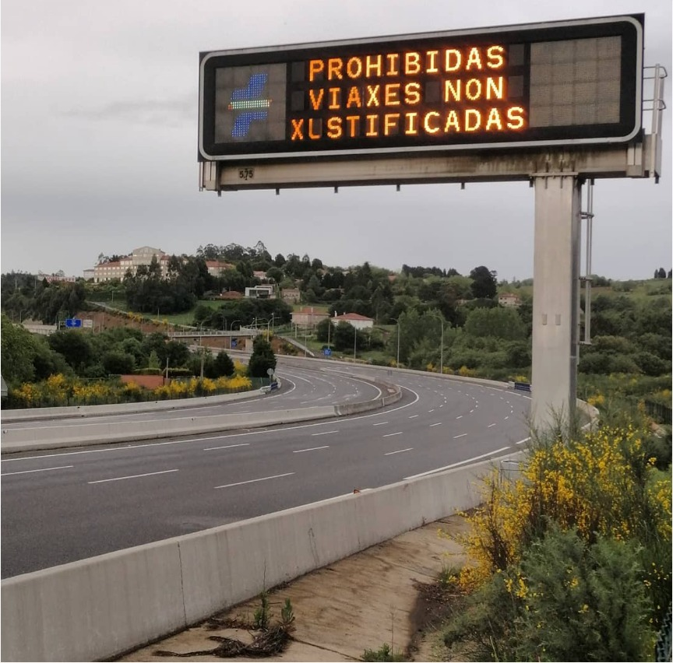
John Whitelegg
"We must stop associating mobility with progress, happiness and quality of life"
Juan Alayo
"Cities must maximize accessibility and minimize mobility"
Whitelegg, J. (2016): Mobility. Straw Barnes Press
Notes:
Whitelegg, J. (2016): Mobility. Straw Barnes Press

Slide 19
Julio Pozueta
"The relationship between spatial model and mobility is what confers great importance to urban planning in the development of a particular transport policy.
Indeed, planning, by defining the location and intensity of activities in space, decisively influences the demand for travel and even the type of means of transport suitable for its satisfaction.
Pozueta, J. (2000). Movilidad y planeamiento sostenible: Hacia una consideración inteligente del transporte y la movilidad en el planeamiento y en el diseño urbano. Universidad Complutense de Madrid.
Notes:
Pozueta, J. (2000). Movilidad y planeamiento sostenible: Hacia una consideración inteligente del transporte y la movilidad en el planeamiento y en el diseño urbano. Universidad Complutense de Madrid.

Slide 20
TOURISM FLOWS
Tourist flows are the consequence of travel and mobility of tourists:
a) From their places of residence to the place(s) of destination
b) In tourist destinations
c) In tourist destinations and products based on itinerancy and movement: Camino de Santiago, Interrail, etc.

Slide 21
TOURISM FLOWS IN URBAN TOURISM DESTINATIONS
Once in an urban destination, the tourist has to constantly move
Transfer from the airport, train station, bus or transport terminal to the place of accommodation
Displacements in the destination itself
Round trips to other secondary destinations
Traveling in itinerant cars

Slide 22
OPEN AREAS FLOWS
Most of the trips made by tourists take place in open spaces
Difficulty of registration, counting and statistics
Public spaces: flows can be marked, regulated or restricted, but must be subject to approval by the authorities
They can generally cause conflicts with traffic, with the local population and with the normal functioning of the city.
They give rise to problems that lead to "overtourism"
They can be accompanied by additional problems
They can manifest as general load capacity transfer problems in their different dimensions.
They can produce problems related to the relative or absolute values ​​of the number of tourists
We must distinguish between individuals or small or large groups or mega groups

Slide 23
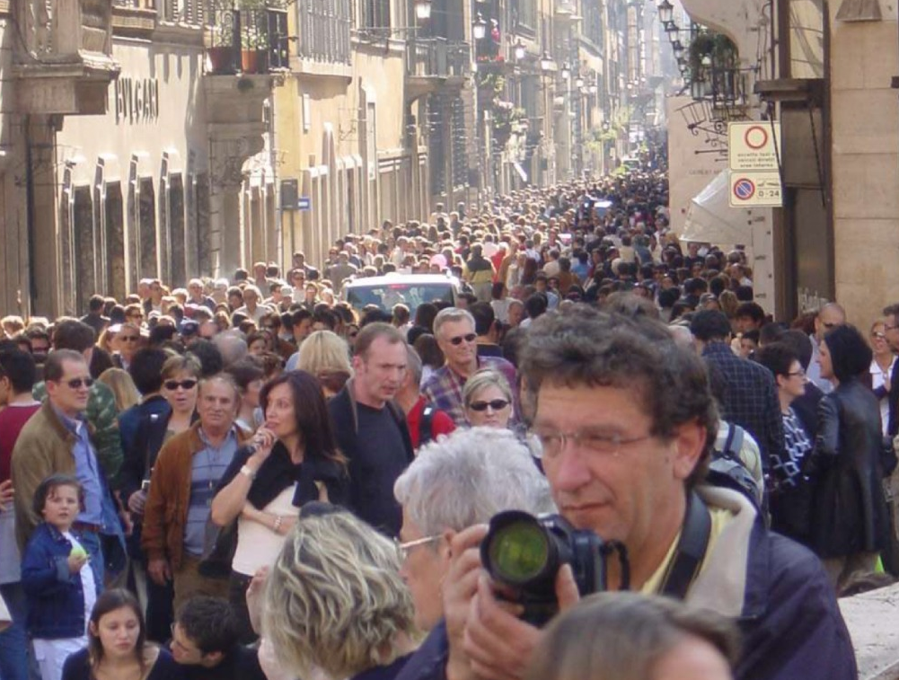
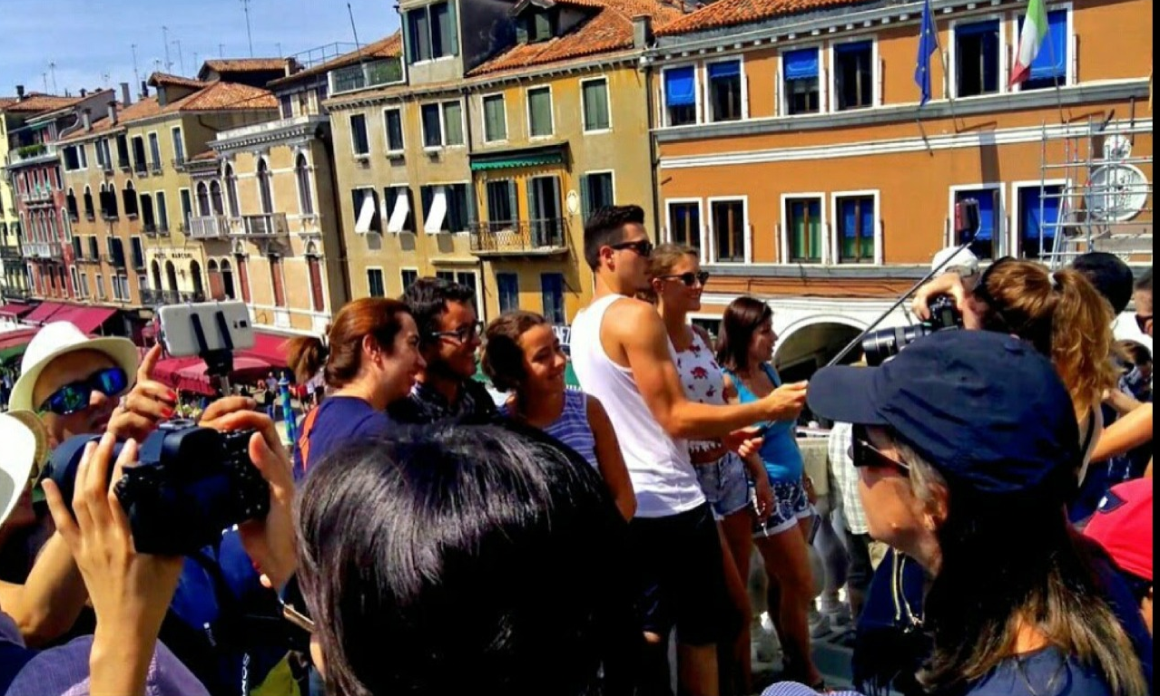
In highly visited urban tourism destinations, there can be significant crowds of visitors, which easily exceed the carrying capacity. This can generate not only a problem of loss of quality of the visit experience, but it can also involve security problems and put the physical integrity of visitors at risk

Slide 24
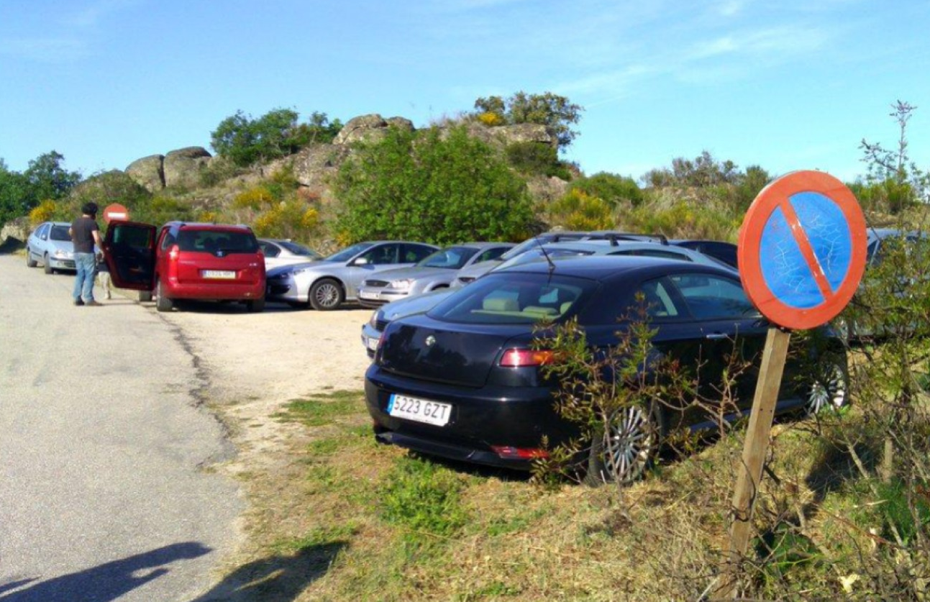
OPEN AREAS FLOWS
Saturation, jams, queues, queues
Static or dynamic management possible
Establishment of physical barriers to mobility
Entrance Fees, Hourly Fees, Individuals/Groups
Book online: favors planning
The non-restriction of vehicles favors the existence of traffic jams
Non-legal or illegal parking
Pedestrian traffic jams
Loss of visit quality
Teso de San Cristóbal (Salamanca).
Cars parked in restricted area

Slide 25
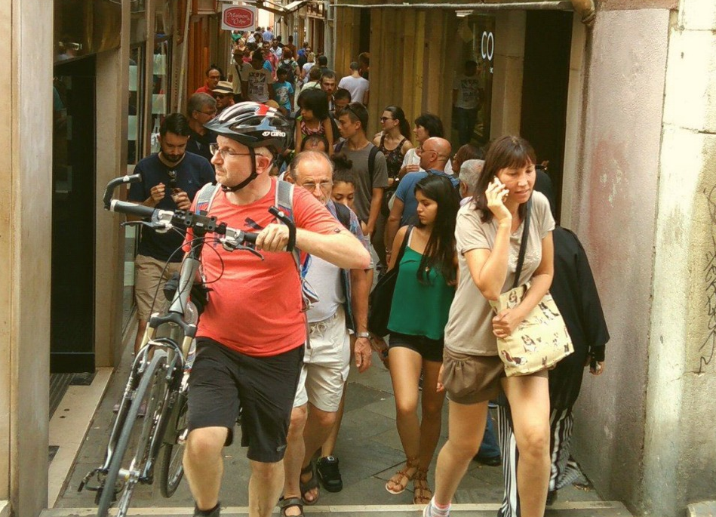
Pedestrian agglomeration in Venice (Italy). High pedestrian flows quickly collapse a road network designed for significantly lower flowspeatonal en Venecia (Italia)

Slide 26
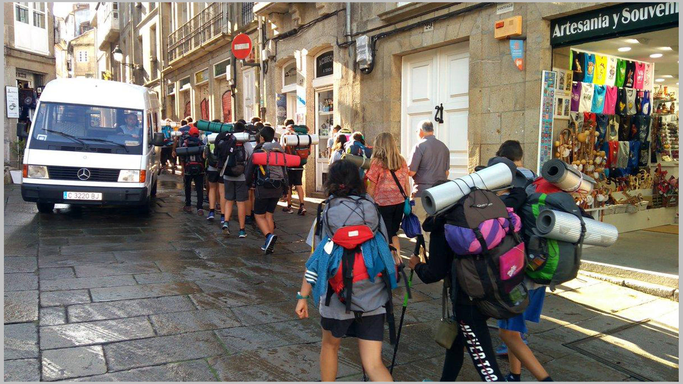
Large groups have a negative impact on urban tourism destinations, especially those with a historic center with a medieval layout, with roads and narrow streets

Slide 27
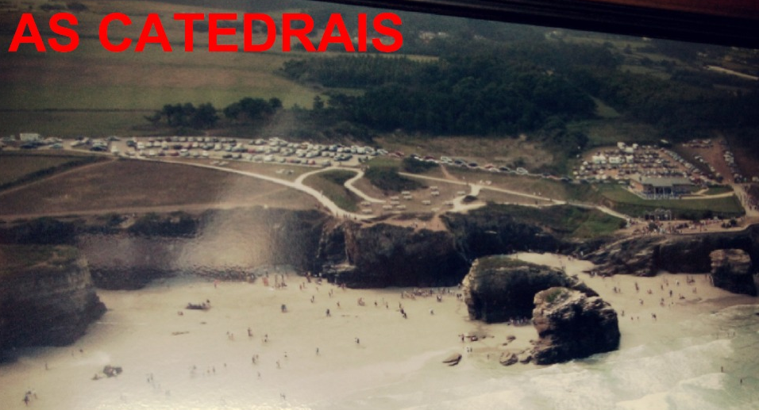
OPEN AREAS FLOWS
It is necessary to move towards flow limitation models
Parking is the most powerful management tool
Parking restriction and establishment of a minimum distance to the resource
You can study the possibility of establishing a rate or not, as well as forcing a temporary rotation
If parking prohibition or restriction measures are not established, cars will reach the resort itself, with the consequent loss of quality of the tourist experience
As Catedrais beach (Lugo). The car park has partially solved the problem, since it is located within the Natural Monument itself, a figure of regional protection

Slide 28
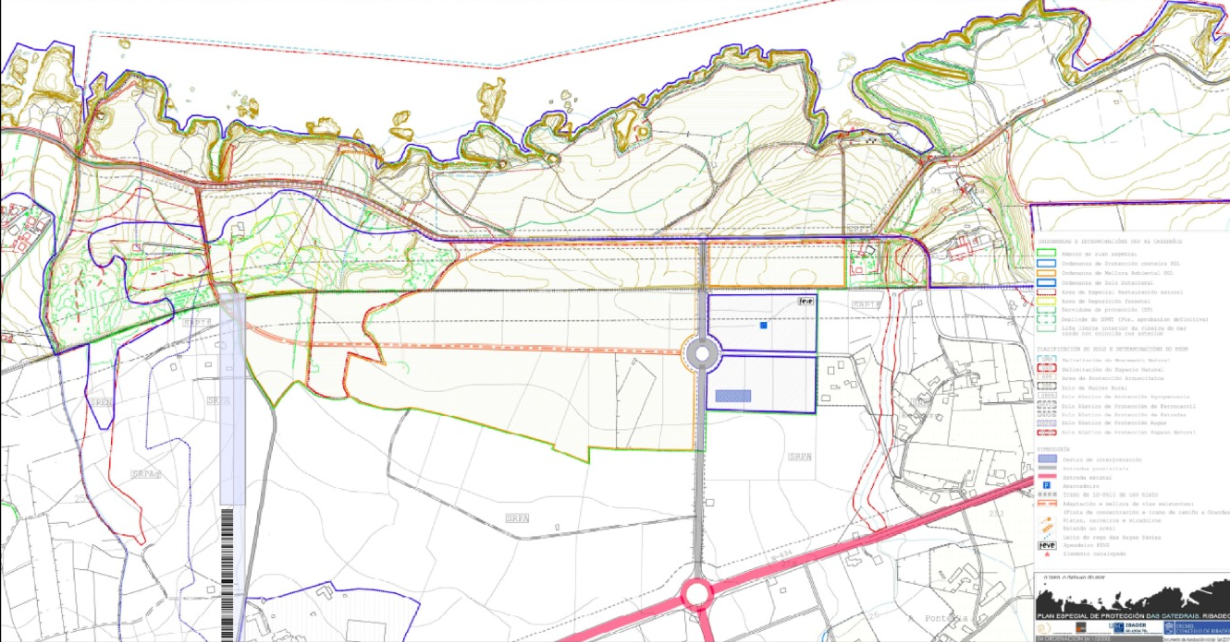
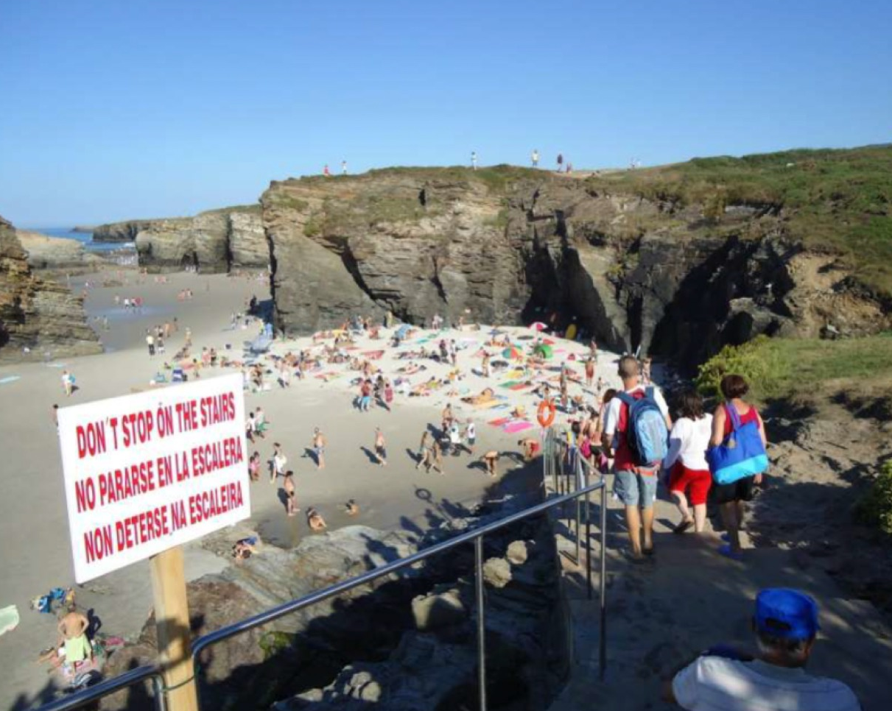
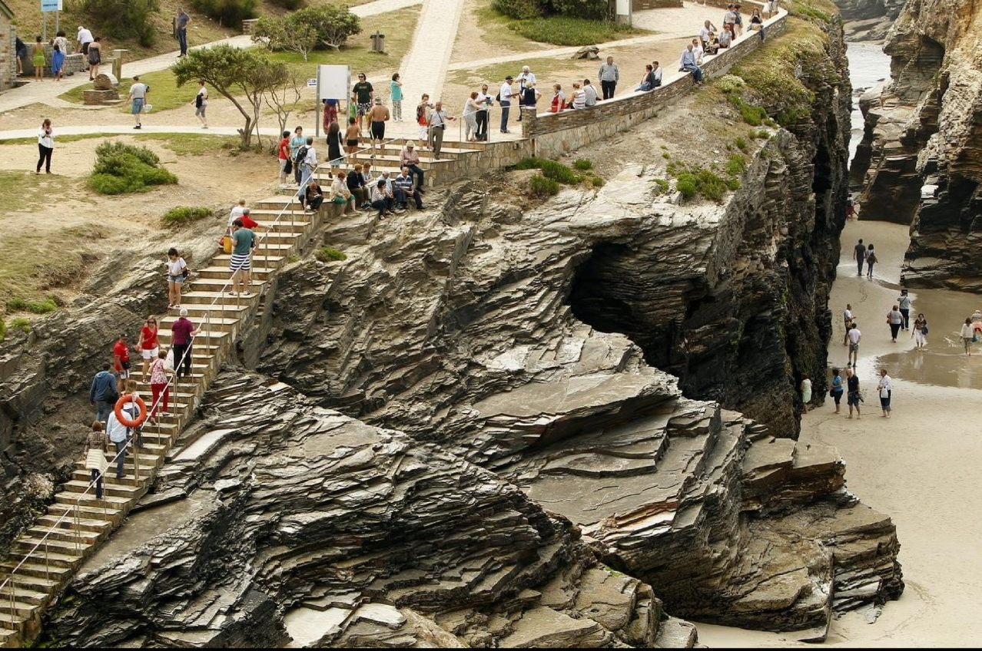
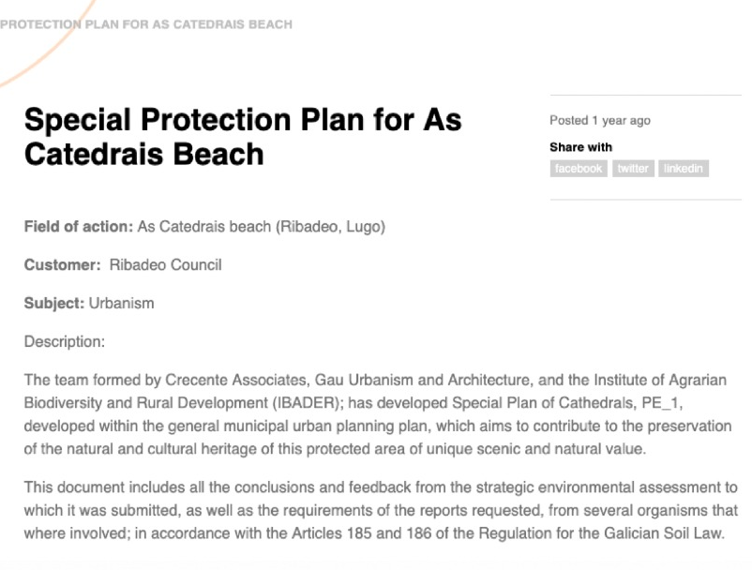
OPEN AREAS FLOWS

Slide 29
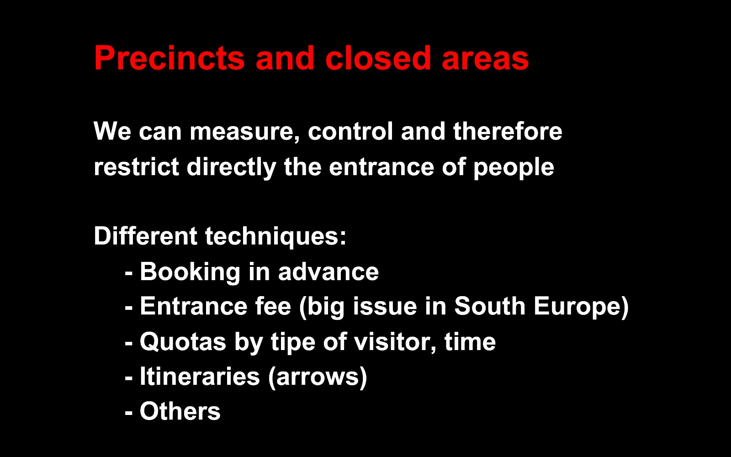
FLOWS IN CLOSED AREAS (PRECINCTS)

Slide 30
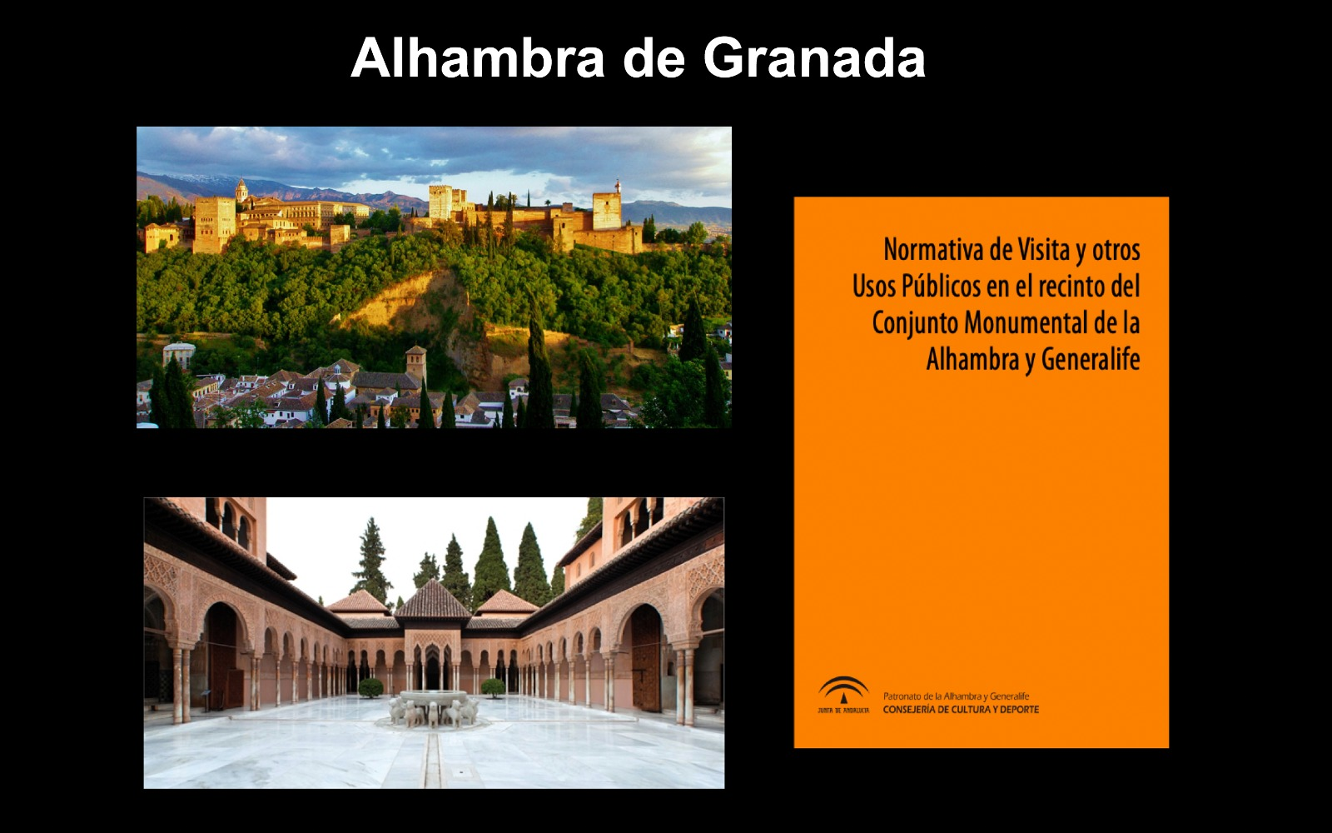
FLOWS IN CLOSED AREAS (PRECINCTS)

Slide 31
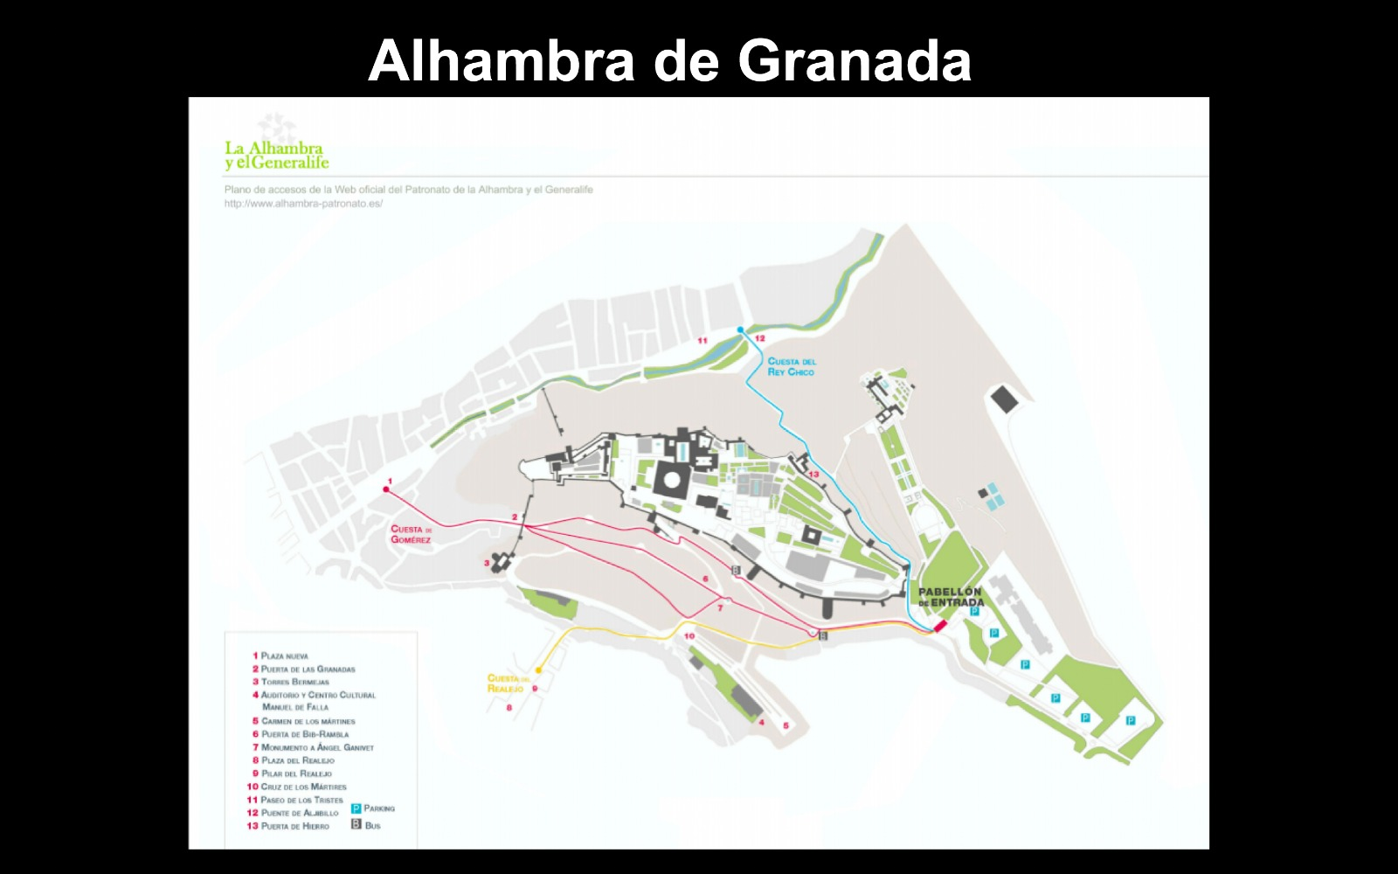
FLOWS IN CLOSED AREAS (PRECINCTS)

Slide 32
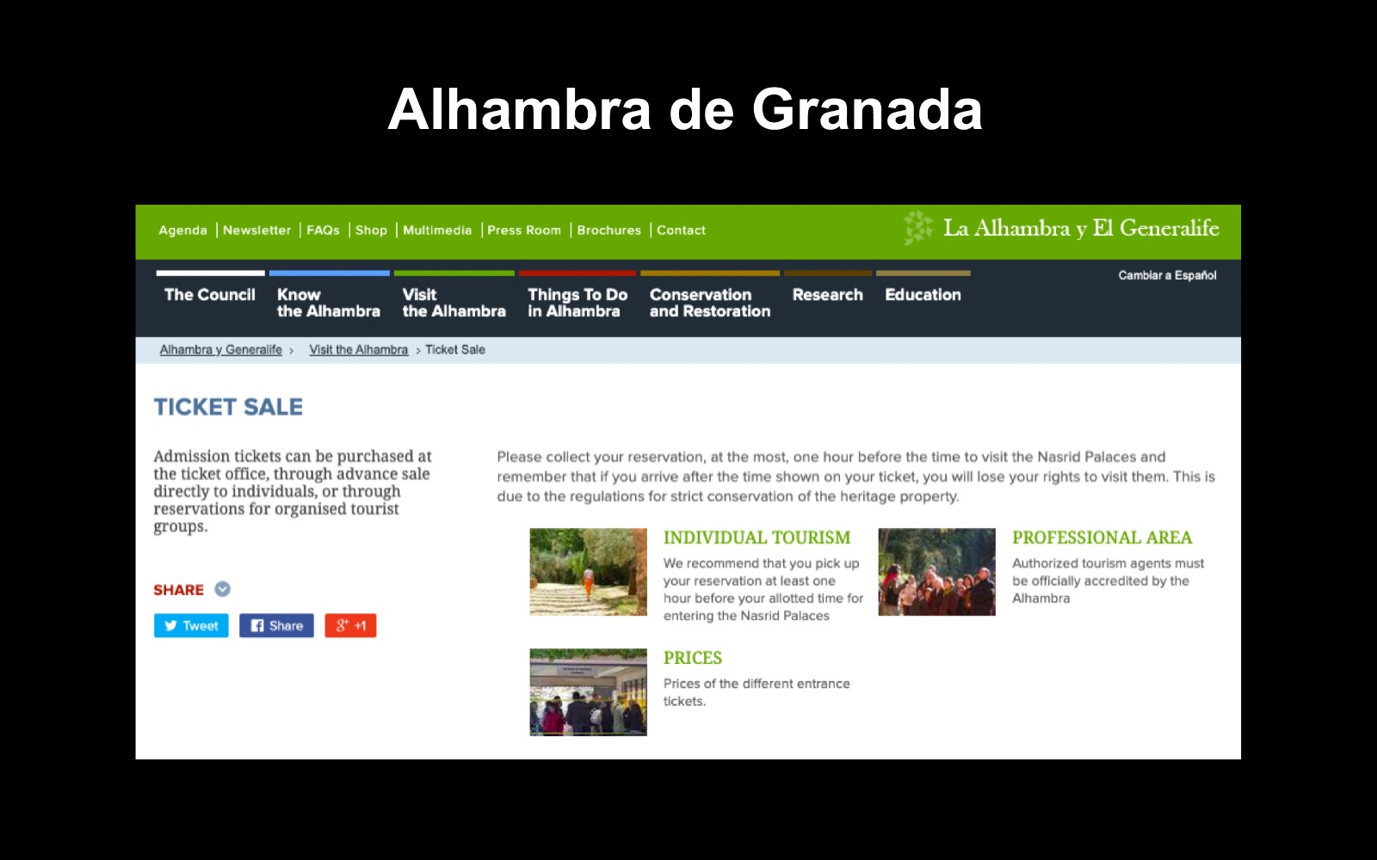
FLOWS IN CLOSED AREAS (PRECINCTS)

Slide 33
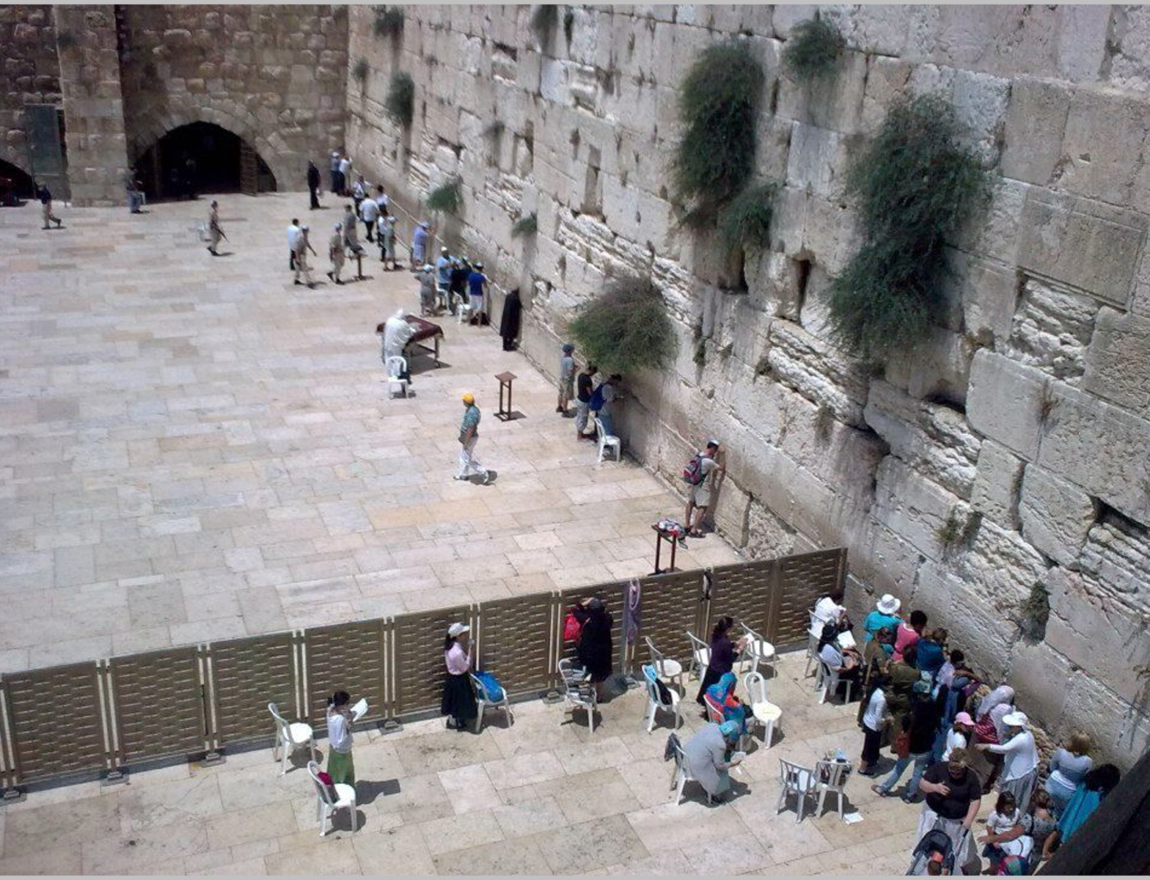
Separation and segregation of flows by gender at the Wailing Wall (Jerusalem, Israel)

Slide 34
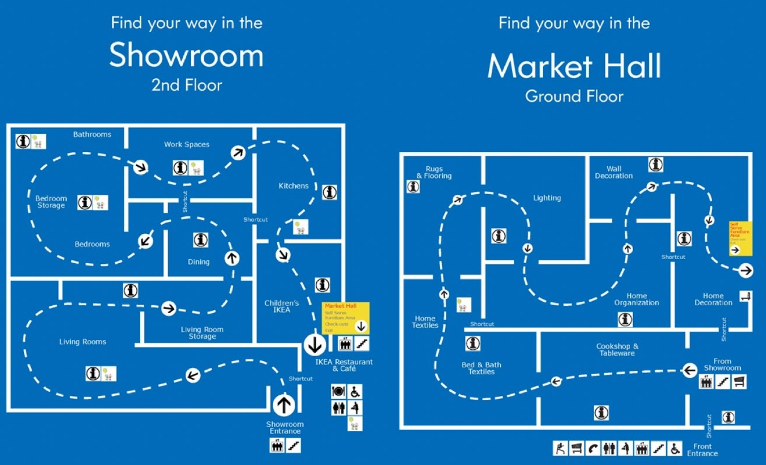
FLOWS IN CLOSED AREAS (PRECINCTS)
There are different ways of channeling the flow of visitors in shops and commercial spaces in which we can be inspired to manage tourist flows, such as the well-known IKEA strategy for customers to visit all sections of the store

Slide 35
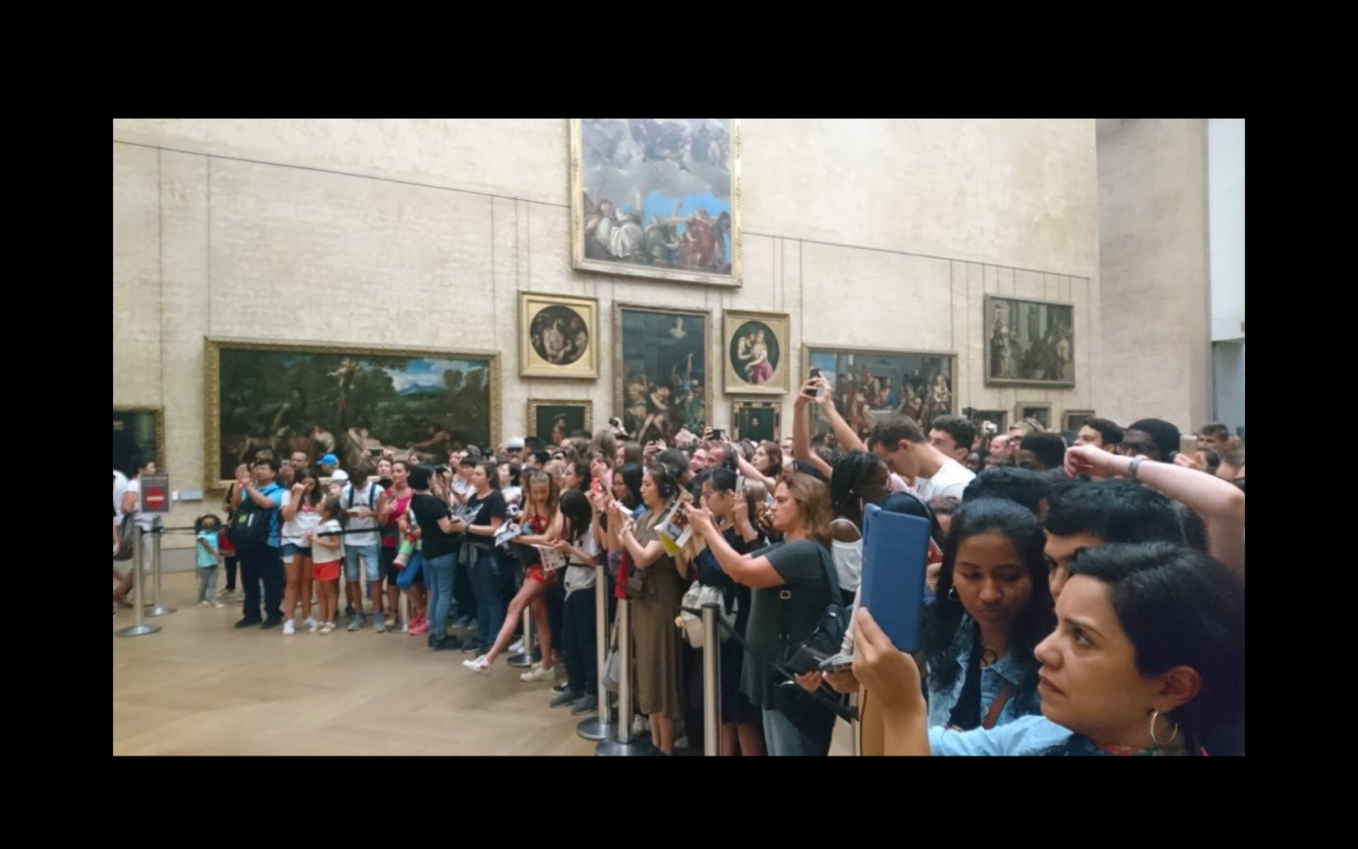
FLOWS IN CLOSED AREAS (PRECINCTS)

Slide 36
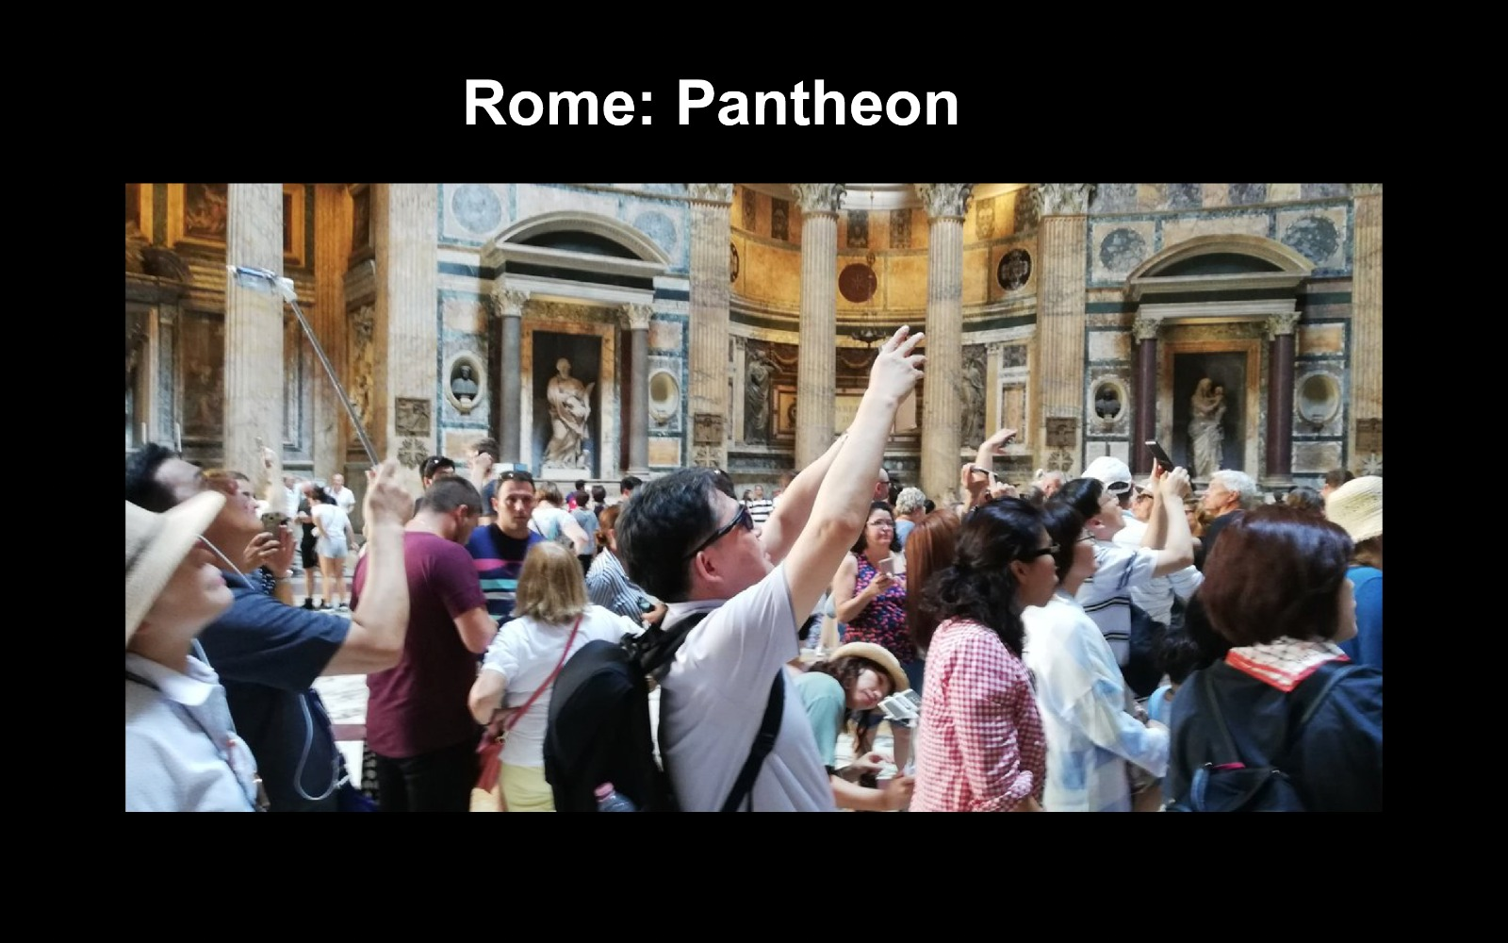
FLOWS IN CLOSED AREAS (PRECINCTS)

Slide 37
CARRYING CAPACITY CONCEPT
3 DIMENSIONS:
a) Physical-Envinronmental
b) Social
c) Economic

Slide 38
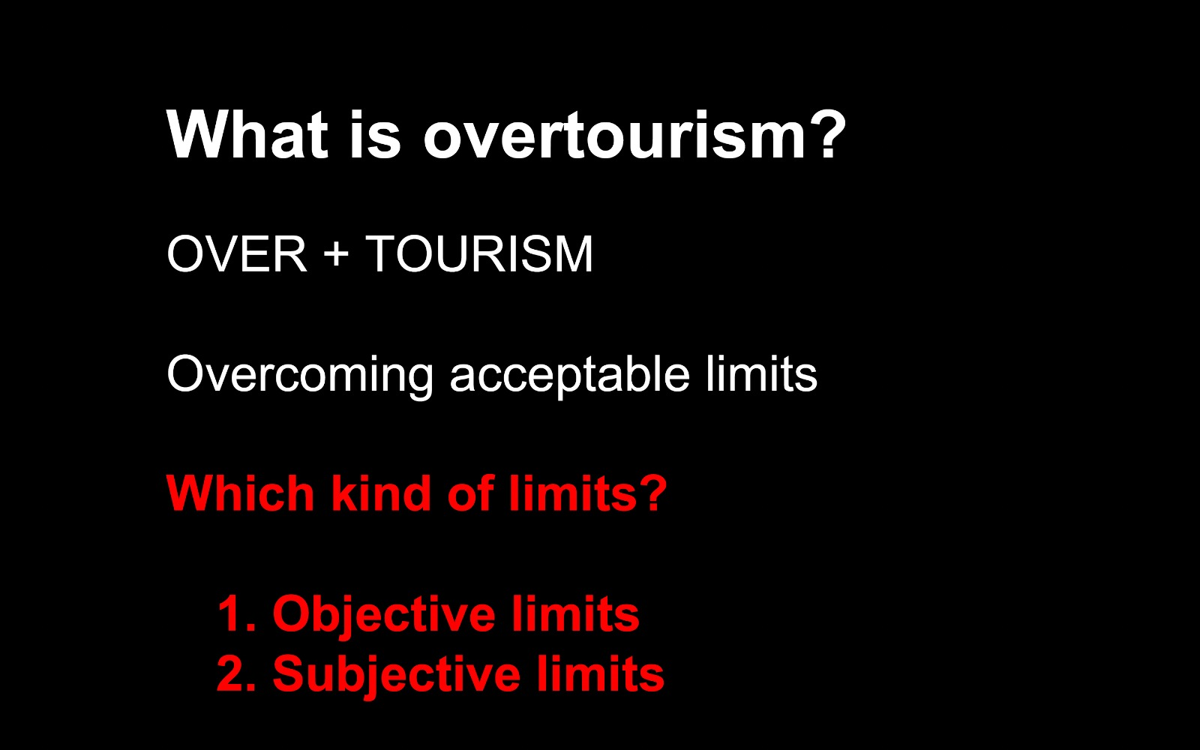
OVERTOURISM

Slide 39
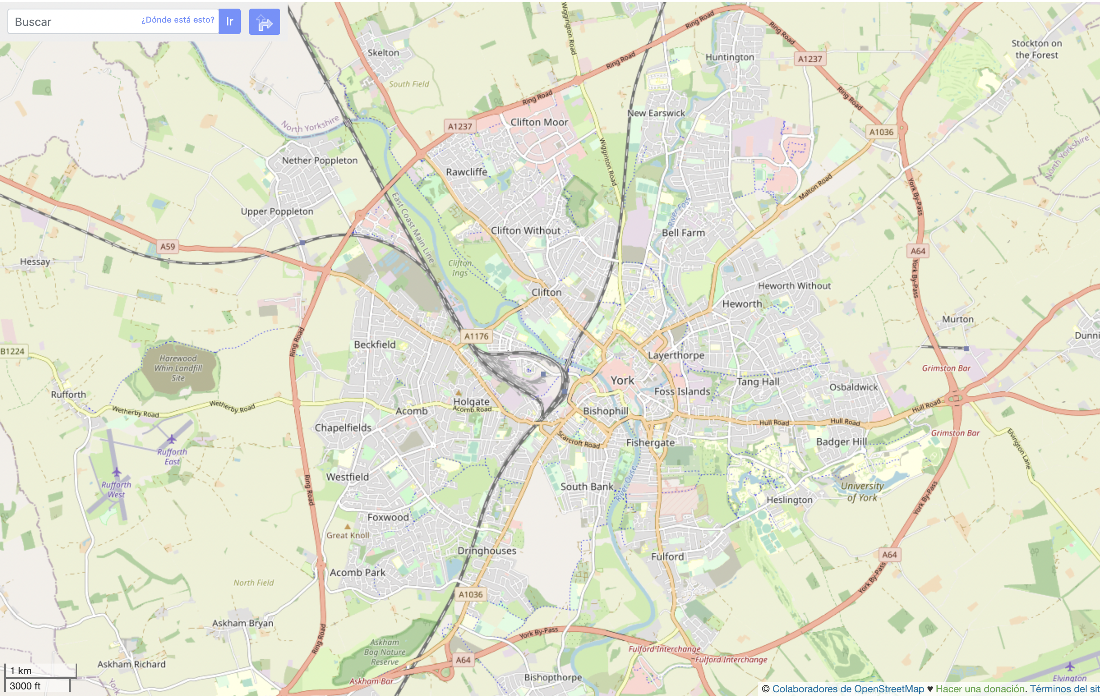
MAIN MOBILITY PROBLEMS IN URBAN TOURISM DESTINATIONS
Central position of historic centers within the cities
York (UK). The Cathedral (Minster) and the walls occupy a central position in the city plan

Slide 40
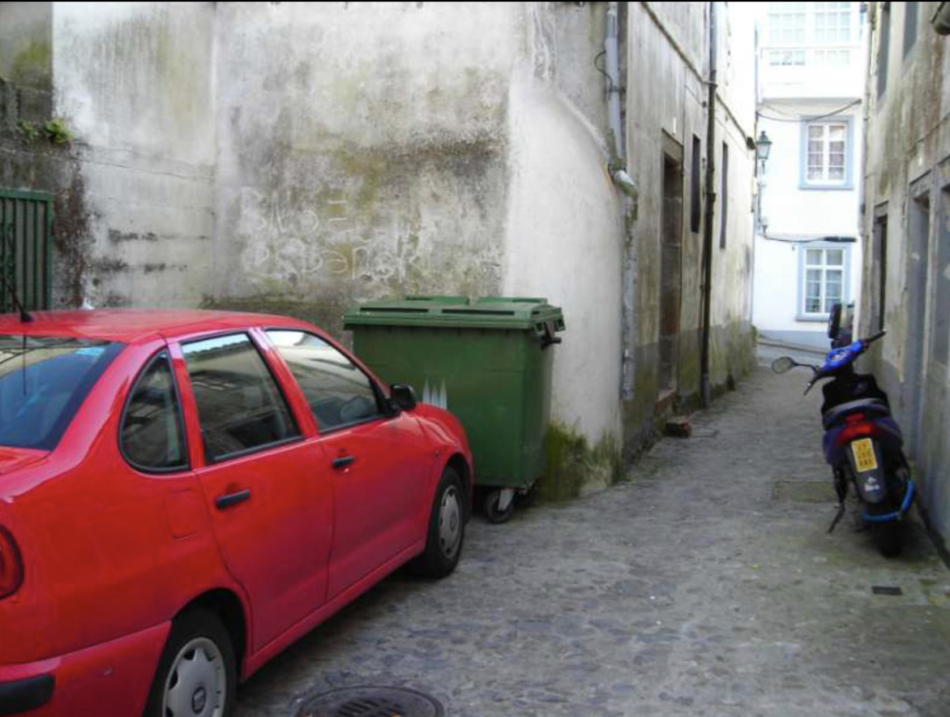
MAIN MOBILITY PROBLEMS IN URBAN TOURISM DESTINATIONS
Special characteristics of the streets
Santiago de Compostela. Rúa do Campo do Forno

Slide 41
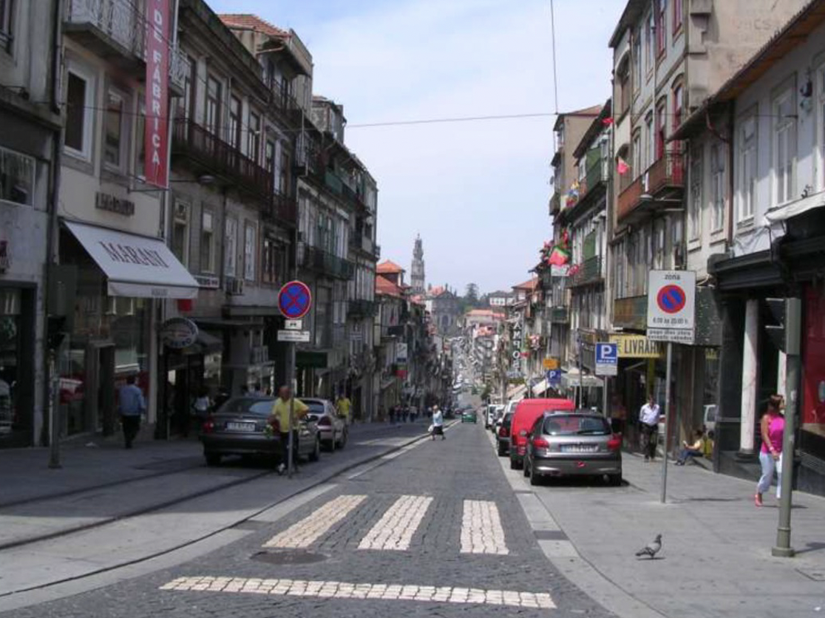
MAIN MOBILITY PROBLEMS IN URBAN TOURISM DESTINATIONS
Concentration of tertiary activities in historic centers of the cities
Porto. Besides
Praça da Batalha

Slide 42
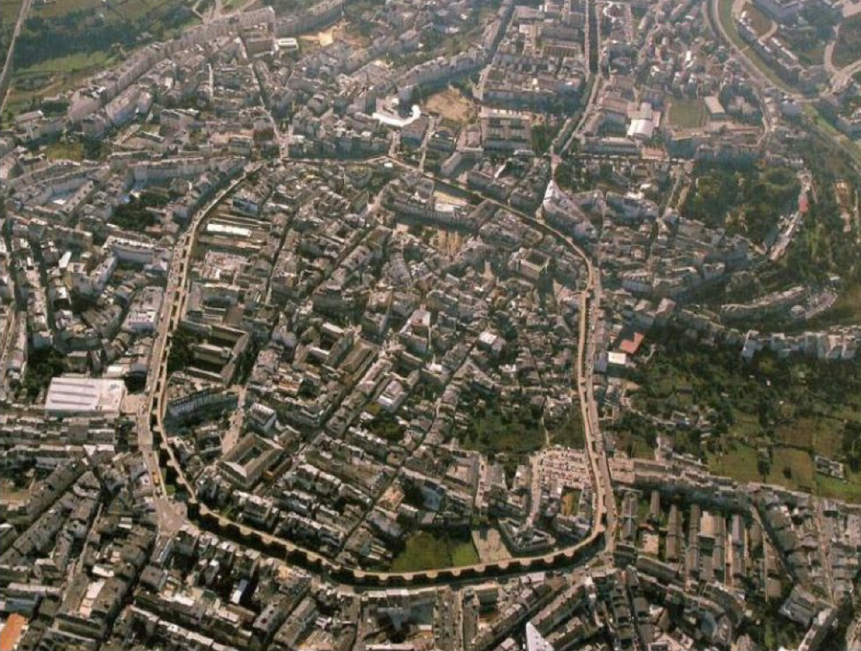
MAIN MOBILITY PROBLEMS IN URBAN TOURISM DESTINATIONS
Concentration in historic cities of main buildings
with historic interest
Lugo. The Roman Wall is a World Heritage Site recognized by UNESCO

Slide 43
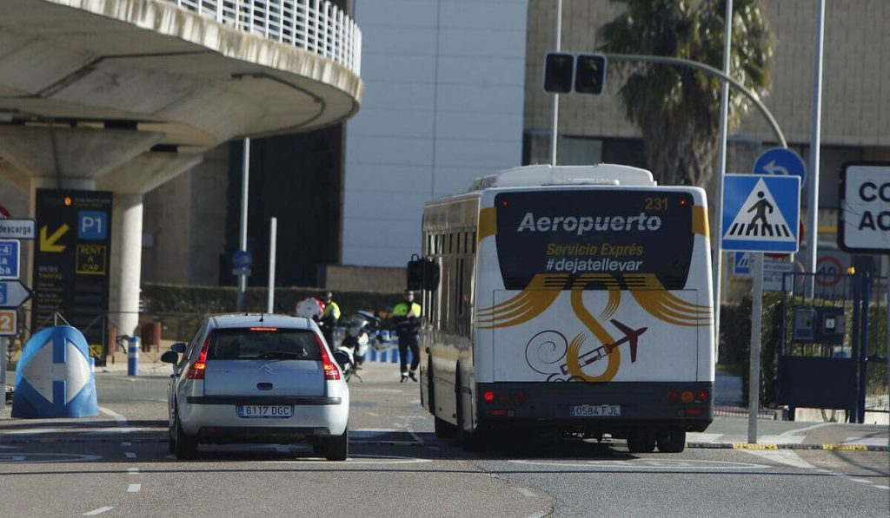
MAIN MOBILITY PROBLEMS IN URBAN TOURISM DESTINATIONS
City-Airport connection

Slide 44
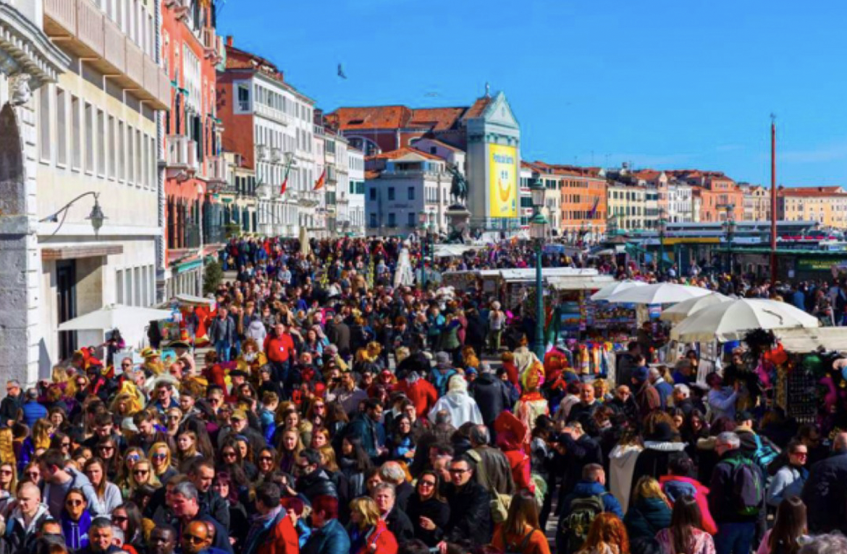
MAIN MOBILITY PROBLEMS IN URBAN TOURISM DESTINATIONS
Overtourism. Too big groups and concentrations of people

Slide 45
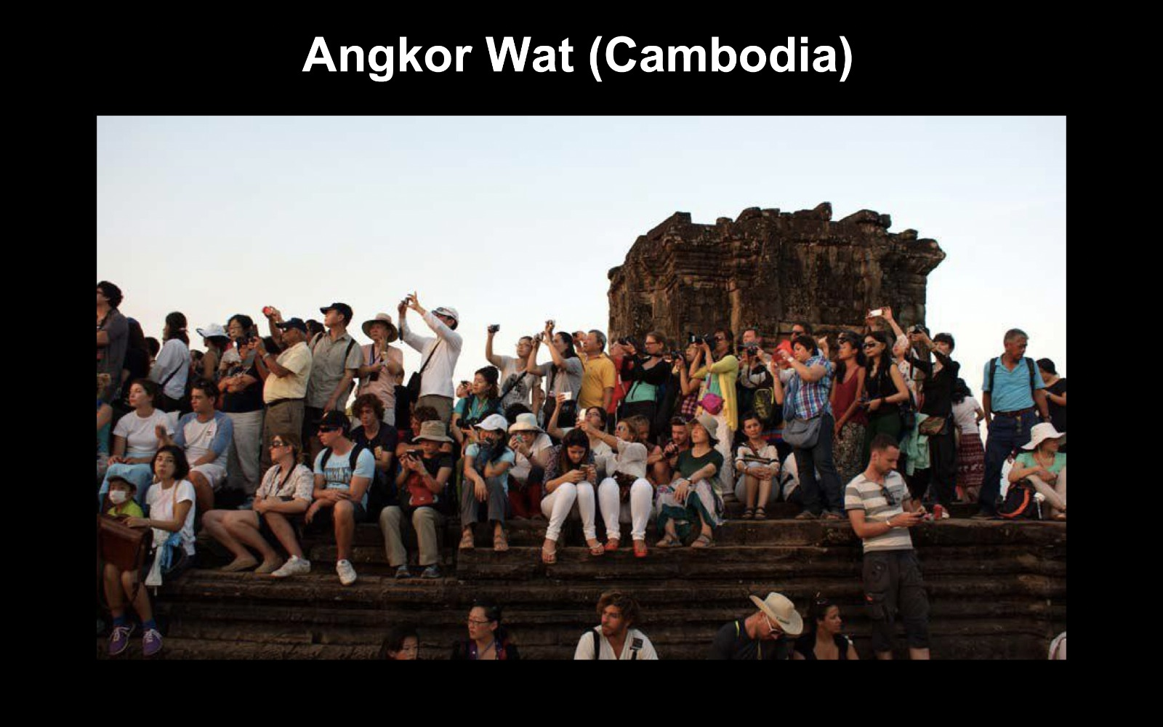
MAIN MOBILITY PROBLEMS IN URBAN TOURISM DESTINATIONS
Overtourism. Too big groups and concentrations of people

Slide 46
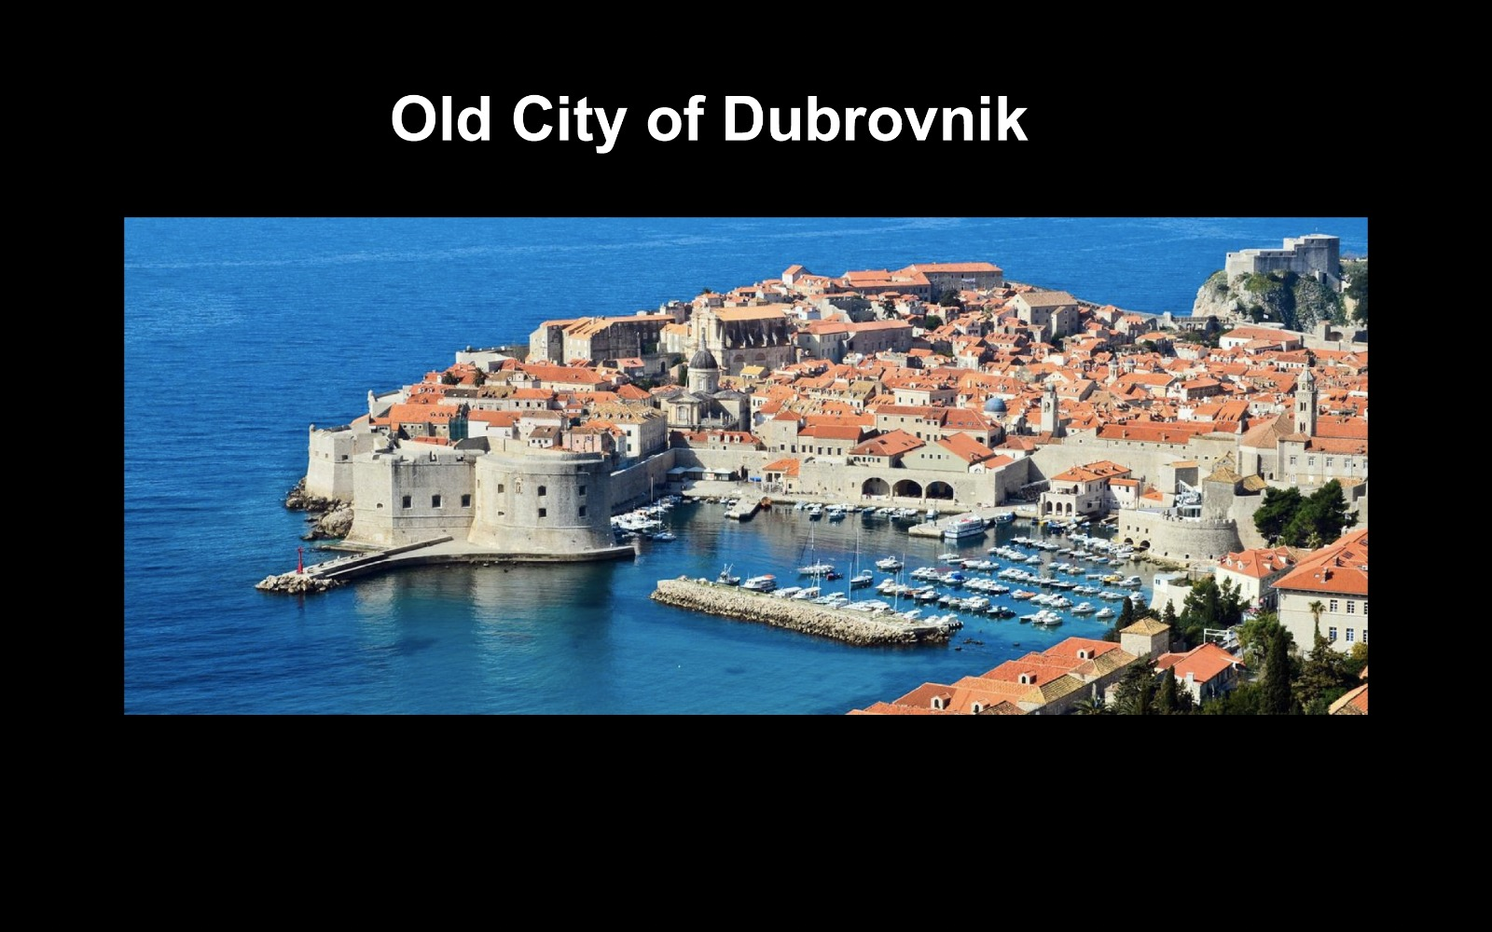
MAIN MOBILITY PROBLEMS IN URBAN TOURISM DESTINATIONS
Overtourism. Too big groups and concentrations of people

Slide 47
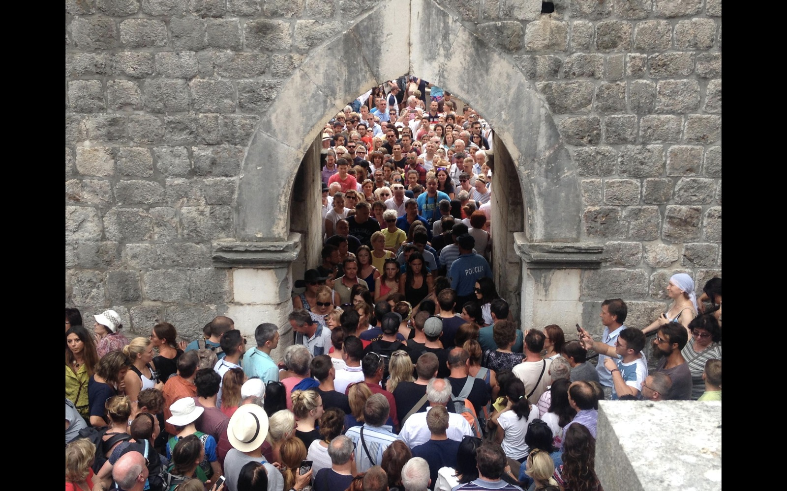
MAIN MOBILITY PROBLEMS IN URBAN TOURISM DESTINATIONS
Overtourism. Too big groups and concentrations of people

Slide 48
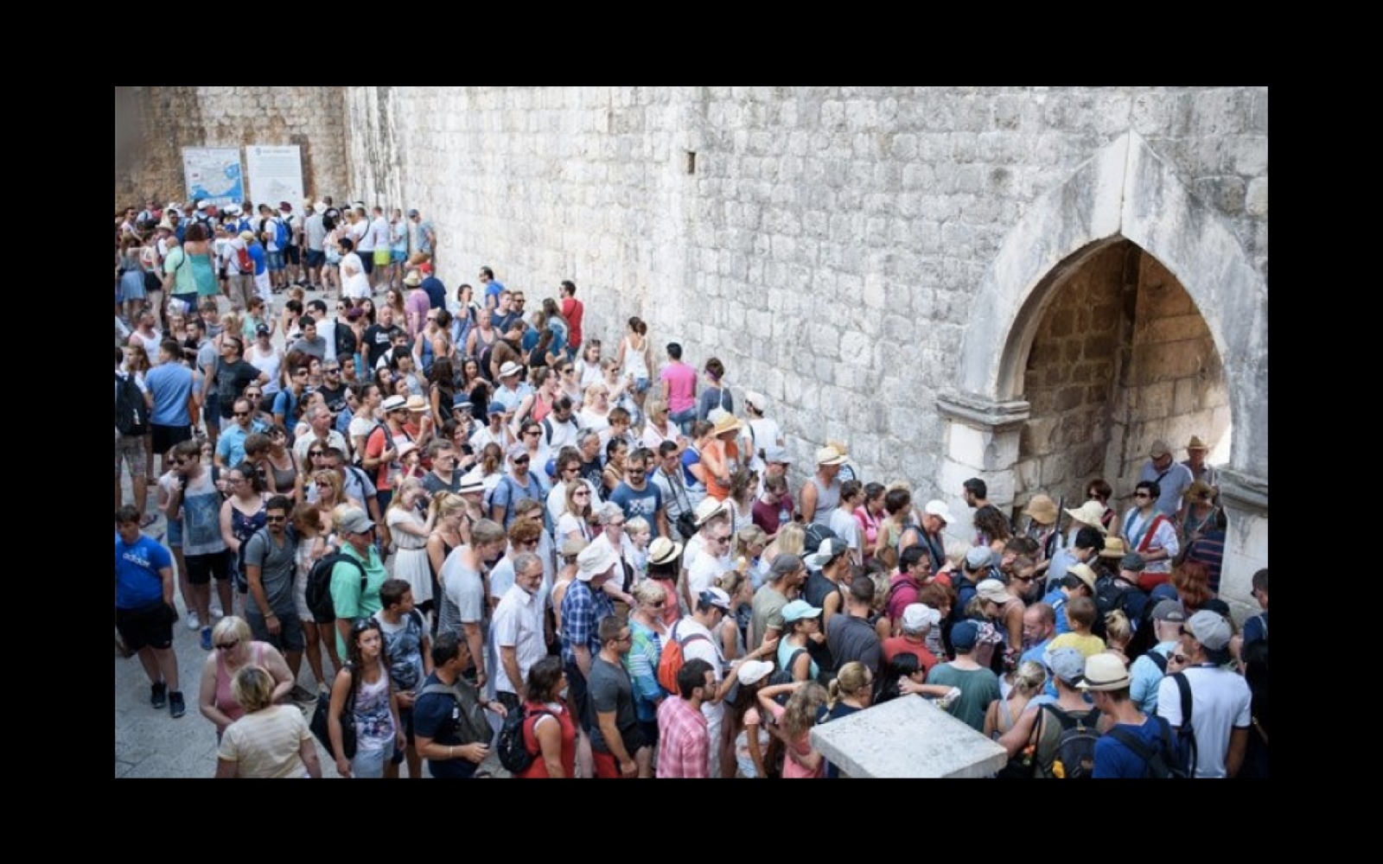
MAIN MOBILITY PROBLEMS IN URBAN TOURISM DESTINATIONS
Overtourism. Too big groups and concentrations of people

Slide 49
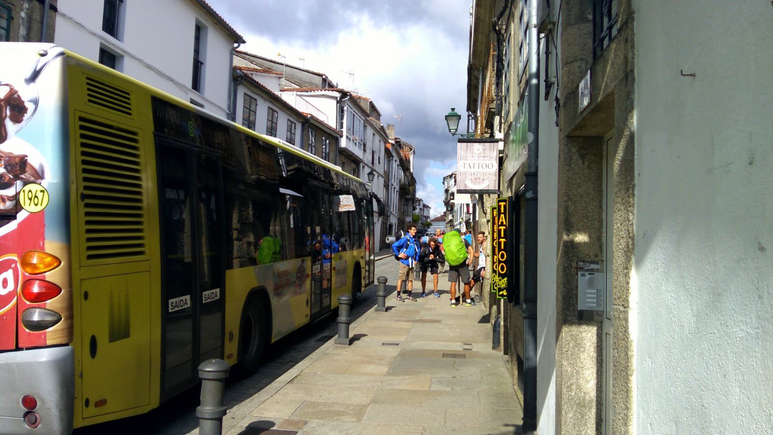
MAIN MOBILITY PROBLEMS IN URBAN TOURISM DESTINATIONS
Difficult adaptation to tourists mobilities transport

Slide 50
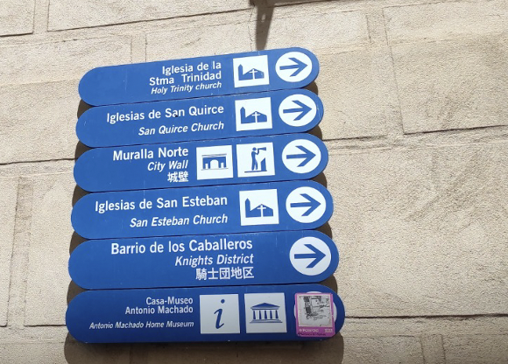
MAIN MOBILITY PROBLEMS IN URBAN TOURISM DESTINATIONS
Information for tourists
Segovia

Slide 51
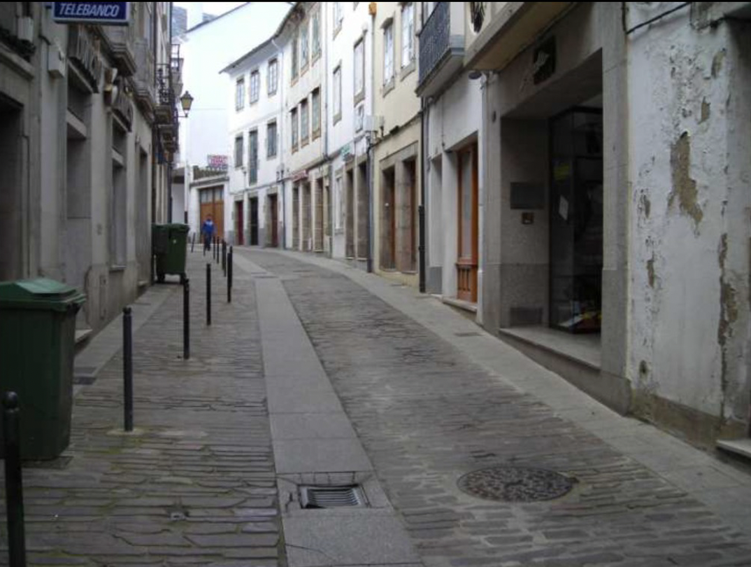
MAIN MOBILITY PROBLEMS IN URBAN TOURISM DESTINATIONS
Lack of pedestrian itineraries
Mondoñedo

Slide 52
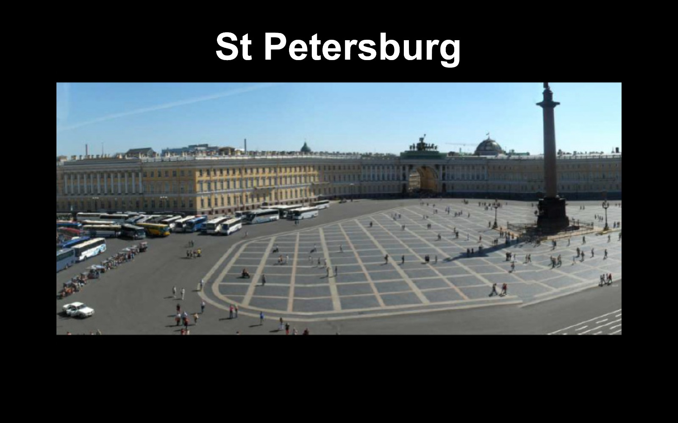
MAIN MOBILITY PROBLEMS IN URBAN TOURISM DESTINATIONS
Lack of pedestrian itineraries

Slide 53
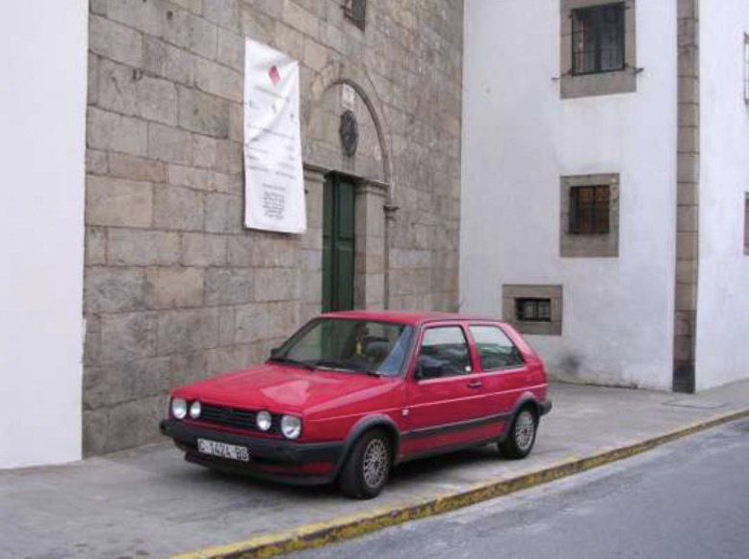
MAIN MOBILITY PROBLEMS IN URBAN TOURISM DESTINATIONS
Environmental and acoustic pollution
The excessive circulation and presence of cars causes air and noise pollution

Slide 54
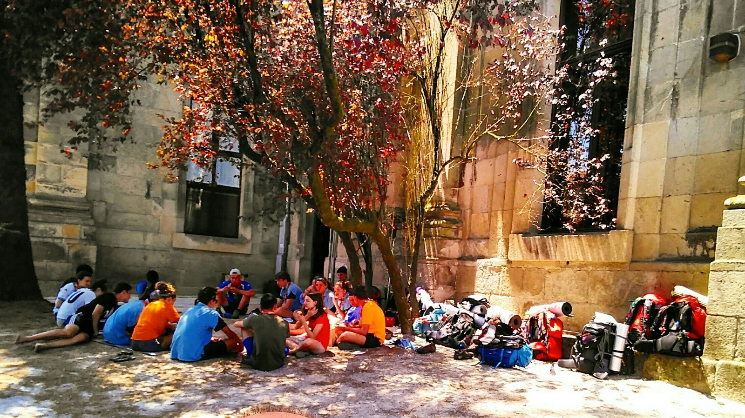
MAIN MOBILITY PROBLEMS IN URBAN TOURISM DESTINATIONS
Aesthetic and visual impact

Slide 55
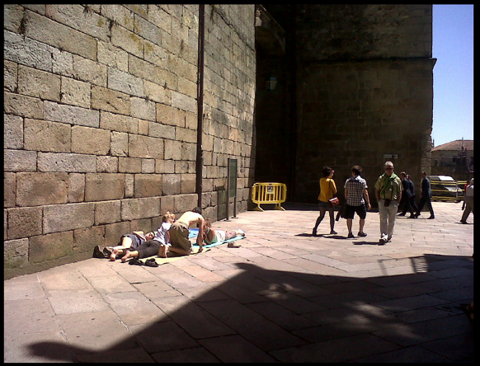
MAIN MOBILITY PROBLEMS IN URBAN TOURISM DESTINATIONS
Aesthetic and visual impact

Slide 56
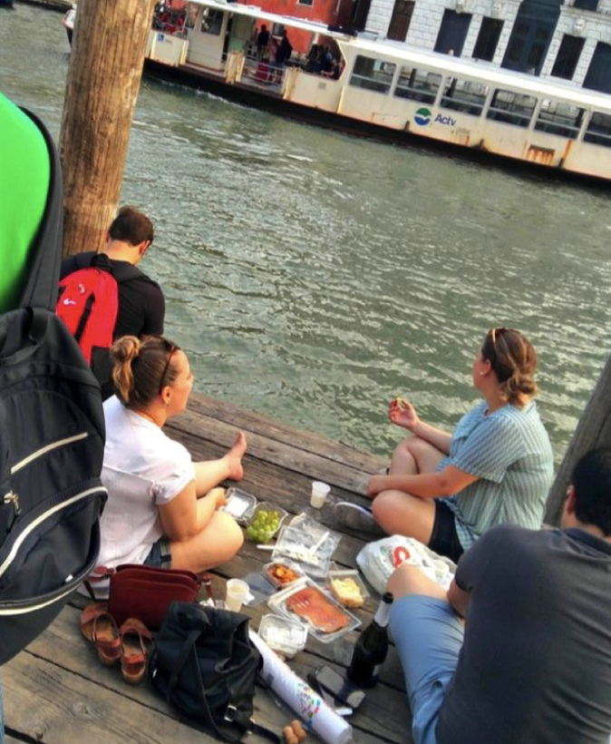
MAIN MOBILITY PROBLEMS IN URBAN TOURISM DESTINATIONS
Aesthetic and visual impact
Grand Canal of Venice. Tourists having a picnic on a gondola jetty

Slide 57
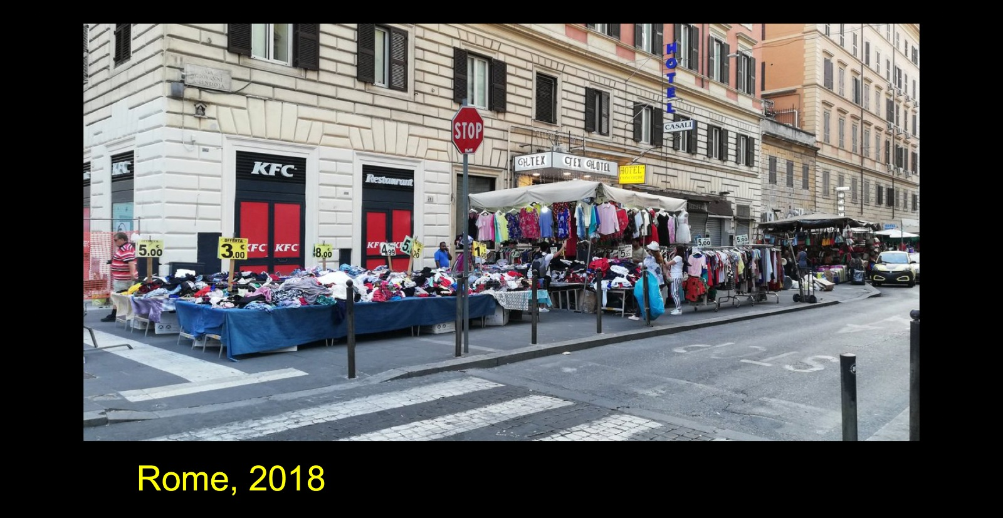
MAIN MOBILITY PROBLEMS IN URBAN TOURISM DESTINATIONS
Conflicts for public spaces

Slide 58
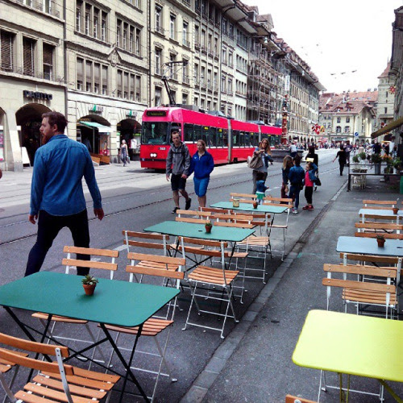
MAIN MOBILITY PROBLEMS IN URBAN TOURISM DESTINATIONS
Obstruction of sidewalks and pedestrian mobility
Zurich. Terraces on the street and on the sidewalk

Slide 59
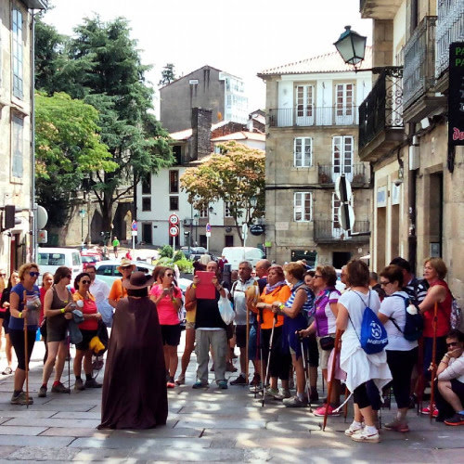
MAIN MOBILITY PROBLEMS IN URBAN TOURISM DESTINATIONS
Banalization of urban space and the tourist experience
Santiago de Compostela. Rúa das Casas Reais

Slide 60
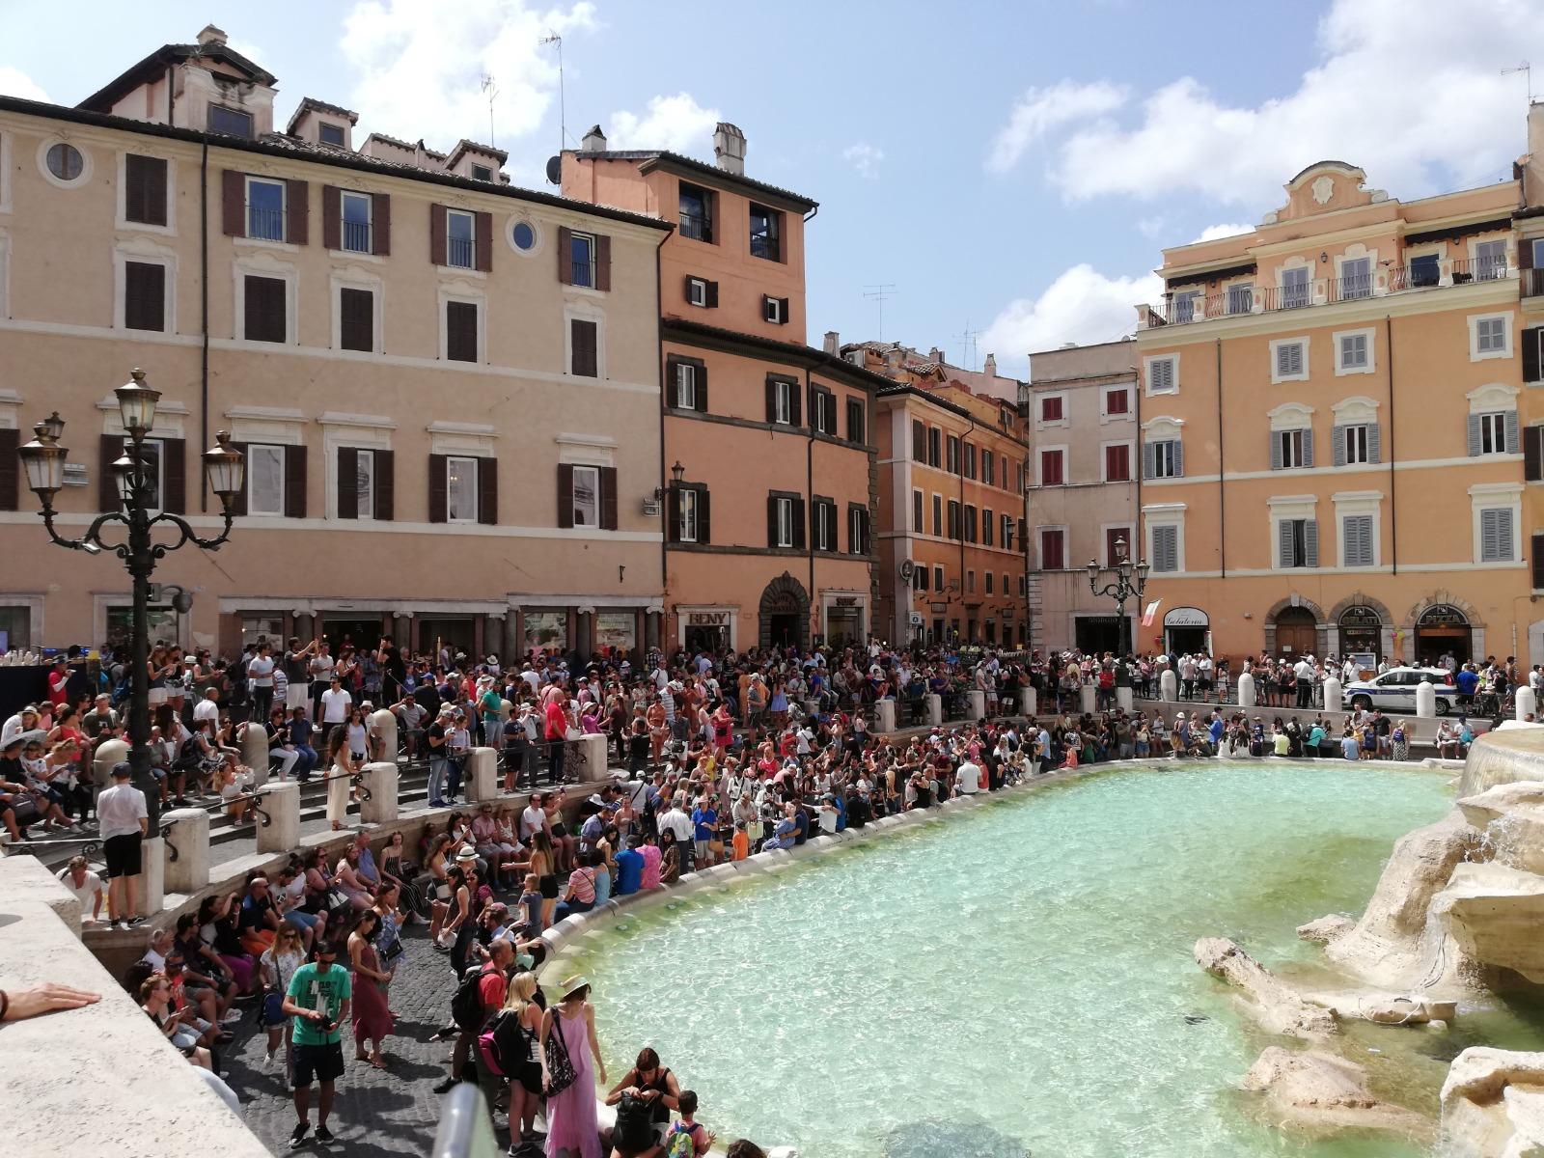
MAIN MOBILITY PROBLEMS IN URBAN TOURISM DESTINATIONS
Banalization of urban space and the tourist experience
Roma.
Fontana de Trevi

Slide 61

MAIN MOBILITY PROBLEMS IN URBAN TOURISM DESTINATIONS
Banalization of urban space and the tourist experience

Slide 62


MAIN MOBILITY PROBLEMS IN URBAN TOURISM DESTINATIONS
Lack of the street as a walking place
Santiago de Compostela

Slide 63


MAIN SOLUTIONS FOR MOBILITY
IN URBAN TOURISM DESTINATIONS
Peripheral car parks
⬅️ Segovia Évora ⬆️

Slide 64

MAIN SOLUTIONS FOR MOBILITY
IN URBAN TOURISM DESTINATIONS
Connection of perimeter car parks with the historic city with buses or hectometric systems
Toledo. Recaredo lift designed by Bernhard Winkler

Slide 65

MAIN SOLUTIONS FOR MOBILITY
IN URBAN TOURISM DESTINATIONS
Connection of perimeter car parks with the historic city with buses or hectometric systems

Slide 66

MAIN SOLUTIONS FOR MOBILITY
IN URBAN TOURISM DESTINATIONS
Connection of perimeter car parks with the historic city with buses or hectometric systems

Slide 67

MAIN SOLUTIONS FOR MOBILITY
IN URBAN TOURISM DESTINATIONS
Hectometric systems
Hong Kong.
SoHo

Slide 68


MAIN SOLUTIONS FOR MOBILITY
IN URBAN TOURISM DESTINATIONS
Regulation and dynamic pricing of parking

Slide 69

MAIN SOLUTIONS FOR MOBILITY
IN URBAN TOURISM DESTINATIONS
Reorganization of the road and of the directions and passage permits

Slide 70

MAIN SOLUTIONS FOR MOBILITY
IN URBAN TOURISM DESTINATIONS
Park areas for residents

Slide 71


MAIN SOLUTIONS FOR MOBILITY
IN URBAN TOURISM DESTINATIONS
Enhancement of pedestrian mobility

Slide 72

MAIN SOLUTIONS FOR MOBILITY
IN URBAN TOURISM DESTINATIONS
Areas of human and soft mobility

Slide 73

MAIN SOLUTIONS FOR MOBILITY
IN URBAN TOURISM DESTINATIONS
Areas of human and soft mobility
Bilbao

Slide 74

MAIN SOLUTIONS FOR MOBILITY
IN URBAN TOURISM DESTINATIONS
Tourism-oriented mobility services
Alhambra de Granada

Slide 75

MAIN SOLUTIONS FOR MOBILITY
IN URBAN TOURISM DESTINATIONS
Improving of signs
Bonn

Slide 76

MAIN SOLUTIONS FOR MOBILITY
IN URBAN TOURISM DESTINATIONS
Mejora de la señalización

Slide 77
CONCLUSIONS
Mobility data in historic centres: conclusions by visitor clusters
Tourist cities >> Historic cities >> specific problems
Carrying capacity, saturation, overtourism, conflicts over public space
Diverse solutions from the field of flow management
mobility management
Comprehensive Approaches
Tourism mobility plans and studies

